Slide 1
Year 11 Raising Achievement Evening
The Journey to Success
Respect, Inspiration, Resilience, Excellence
Mastery, Autonomy, Purpose

Slide 2


Slide 3
Welcome
We are going to be the most successful year group ever at Bishop Barrington Academy
What is success?

Slide 4


Slide 5
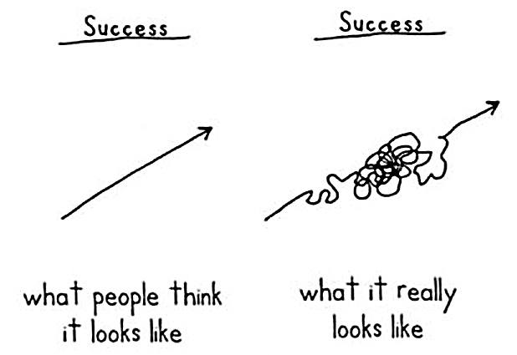
The Journey to Success

Slide 6
The Journey to Success
How do you attribute success or failure?
Don’t be part of the blame game, be part of your solution

Slide 7

The National Fight
2,000,000
380,000
11,000
500,
150,
1

Slide 8

The National Fight
“The hardest working people in County Durham”

Slide 9
Life After Bishop Barrington
Level 3 programmes
T-level or A-levels
Apprenticeship
Traineeship or
Part-time learning whilst working or volunteering
All require you to be successful on August 21st 2025

Slide 10
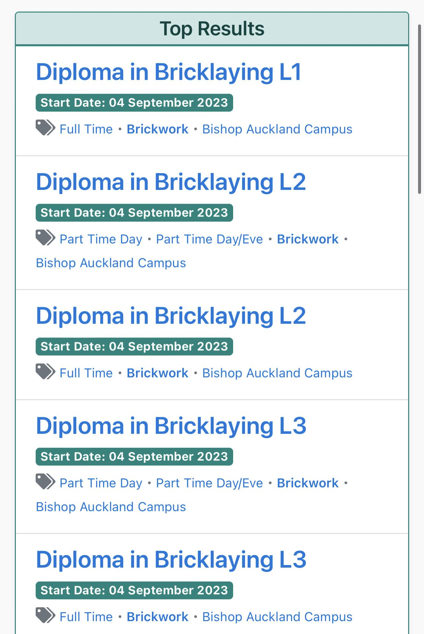
The reality of success in exams
Level 1 – This level includes Study programmes and Traineeships. This is aimed at individuals who have just left school and are looking for some knowledge of your preferred sector and some hands-on experience. This level takes around 4-12 months and isn’t a paid apprenticeship, but all training is free of charge and expenses can be claimed back.
Level 2 – If you enjoyed the training received in Level 1, you can move onto a level 2 apprenticeship. This will be 30-40 hours a week of working in the industry and you will be working towards a Level 2 portfolio and nationally recognised qualifications.
Level 3 – Level 3 is the next step on from level 2 and you will be employed whilst working towards a more advanced qualification.
Course requirements
Minimum 4 GCSE’s at grades 9 - 4 (A* - C) or equivalent, including a 4 or above in Maths and English, or a Level 2 qualification in a relevant subject area.

Slide 11
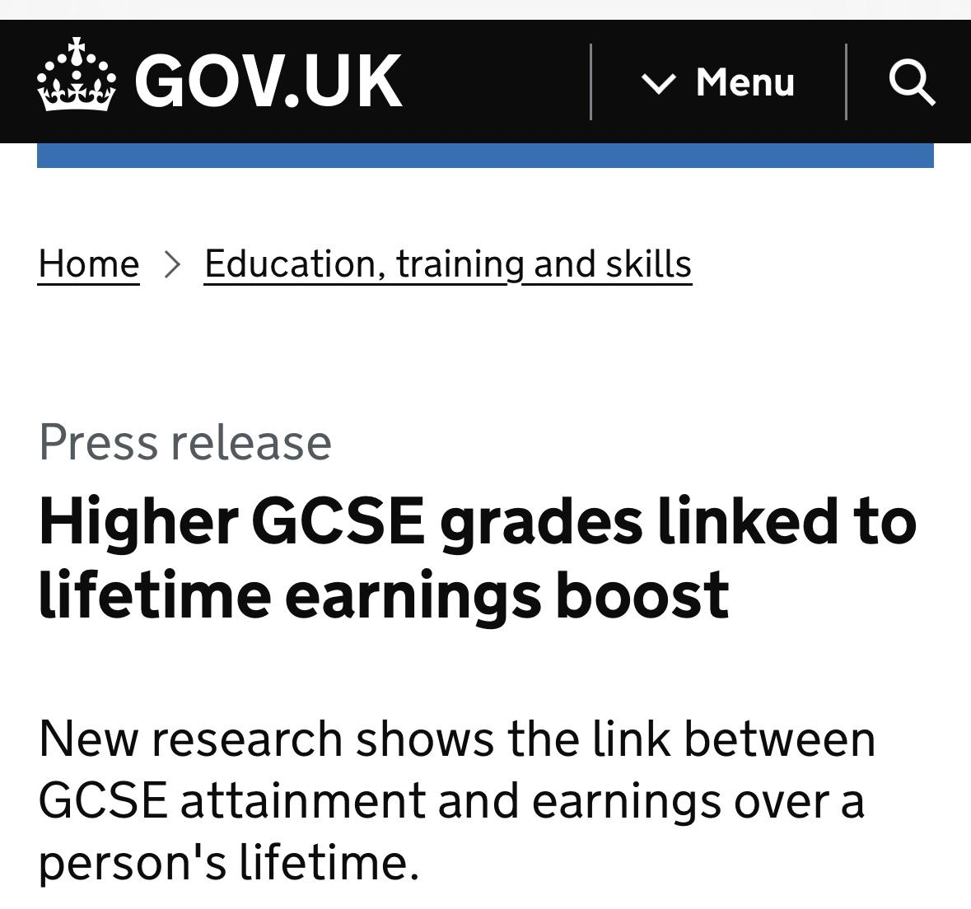
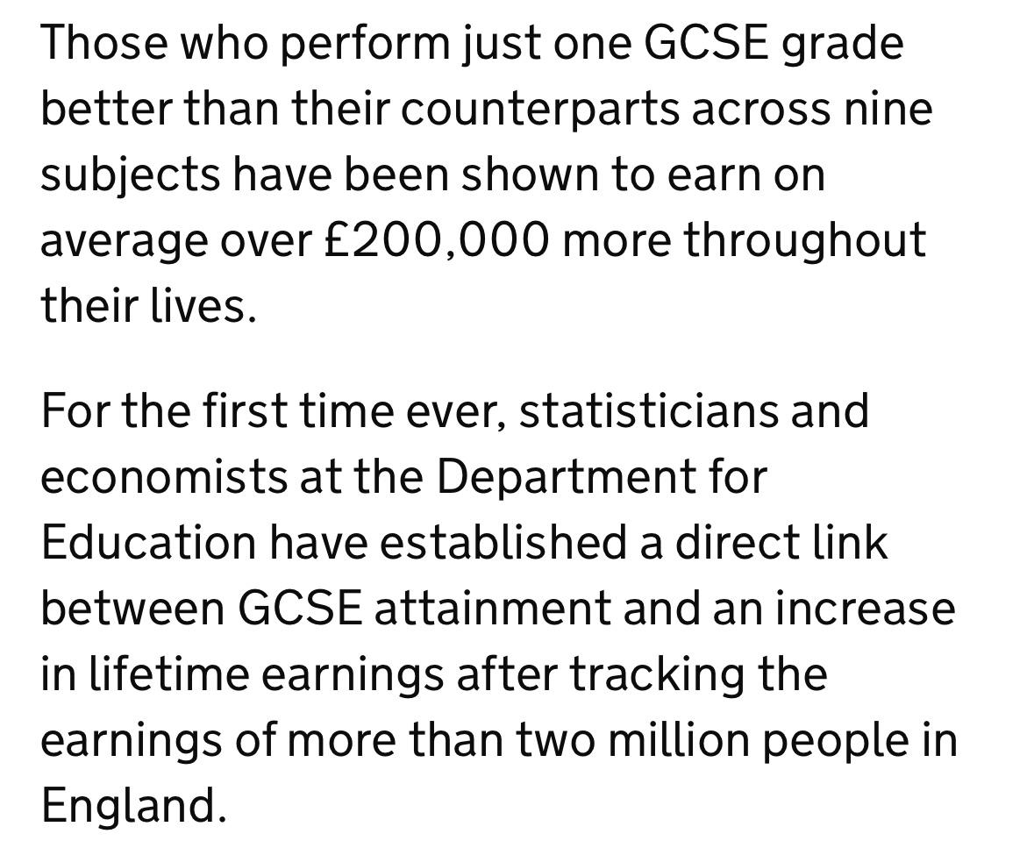
The reality of success in exams

Slide 12
How are we going to be successful?
Respect, Inspiration, Resilience, Excellence
Mastery, Autonomy, Purpose

Slide 13
QFT
Quality First Teaching
Easily the most effective method of making progress.

Slide 14
Learning Habits
Always on Task
“Successful people are not gifted; they just work hard, then succeed on purpose”
“Hard work beats talent when talent doesn't work hard.”

Slide 15
Learning Habits
Always on Task
“The hardest working people in County Durham.”

Slide 16
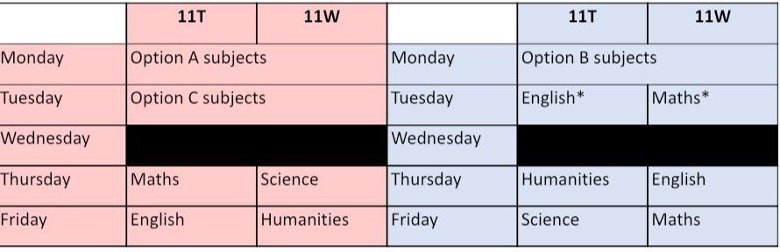
RISE

Slide 17

Project 95
Attendance
Behaviour Ratio
RISE

Slide 18

Revision Residential
March 8th and 9th, 2025
£100 per person
£30 Deposit needed by December 1st

Slide 19
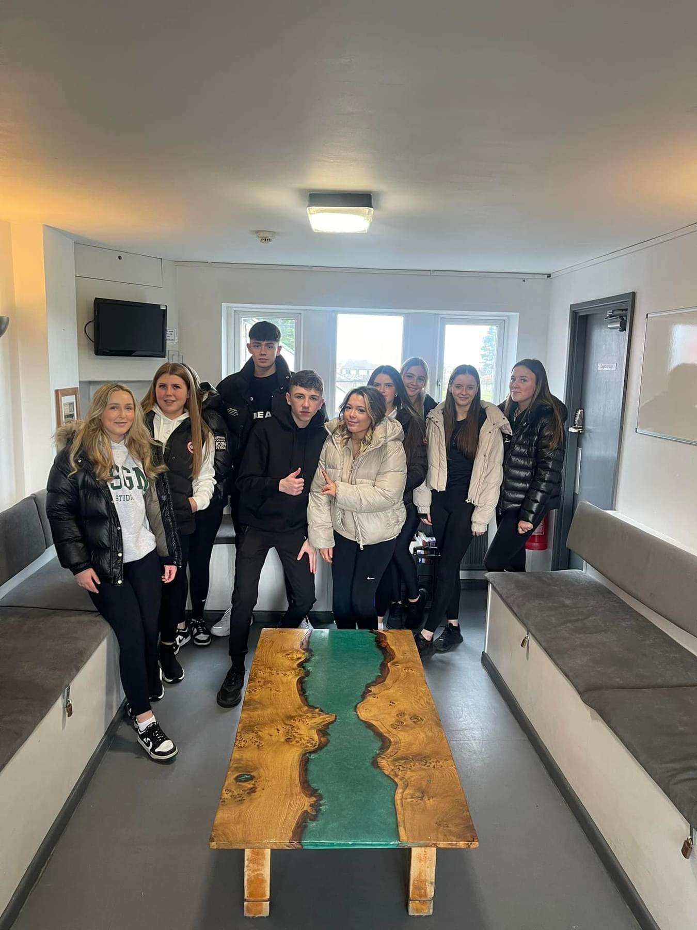
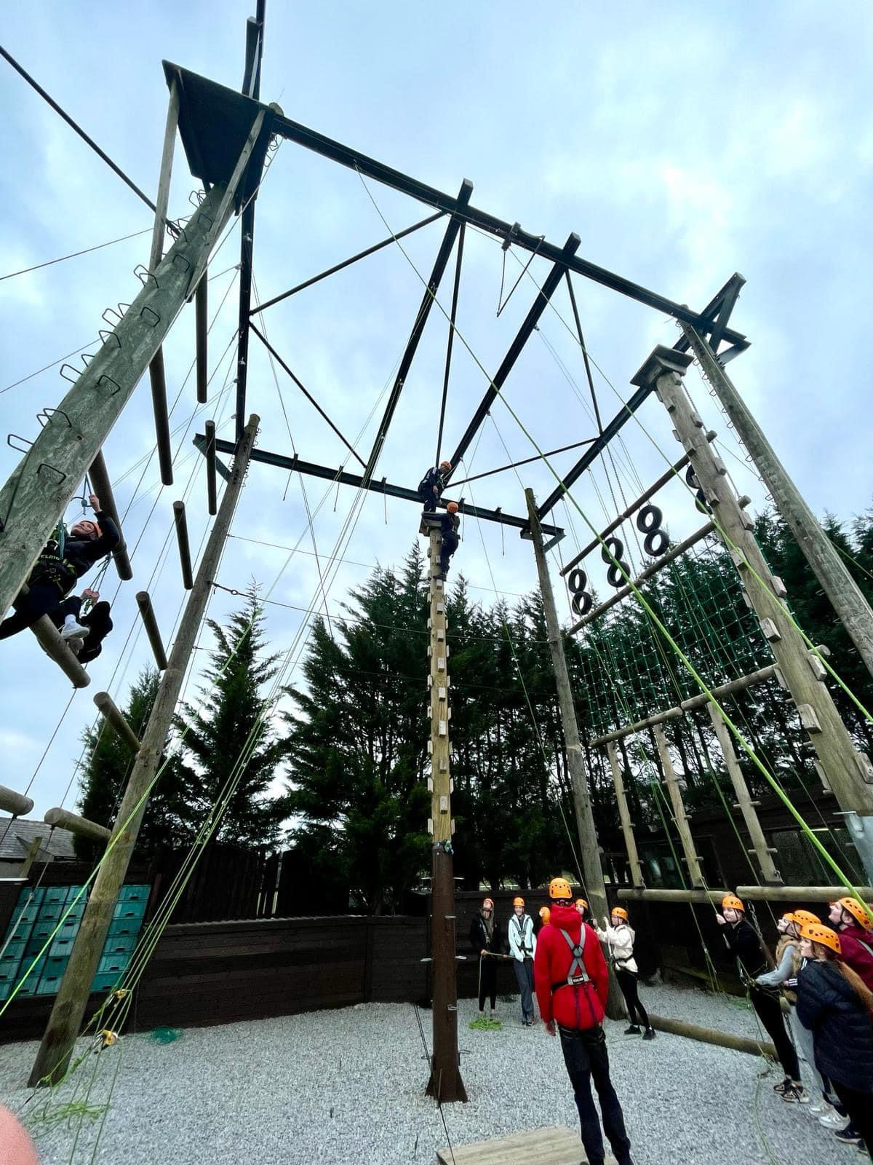
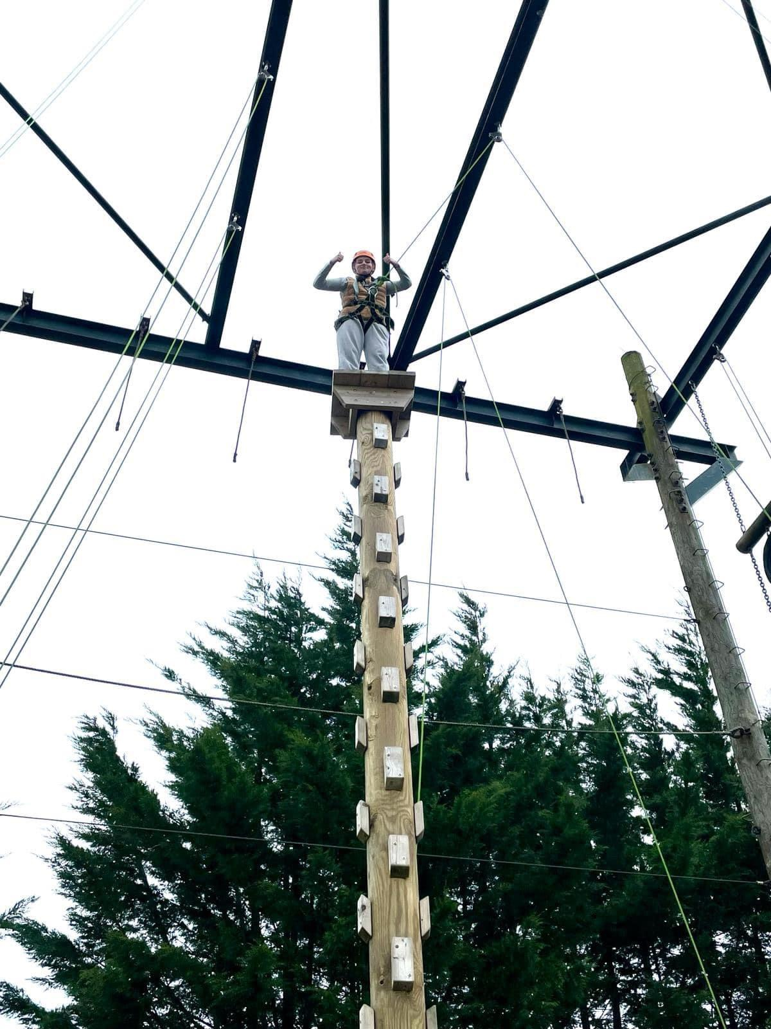

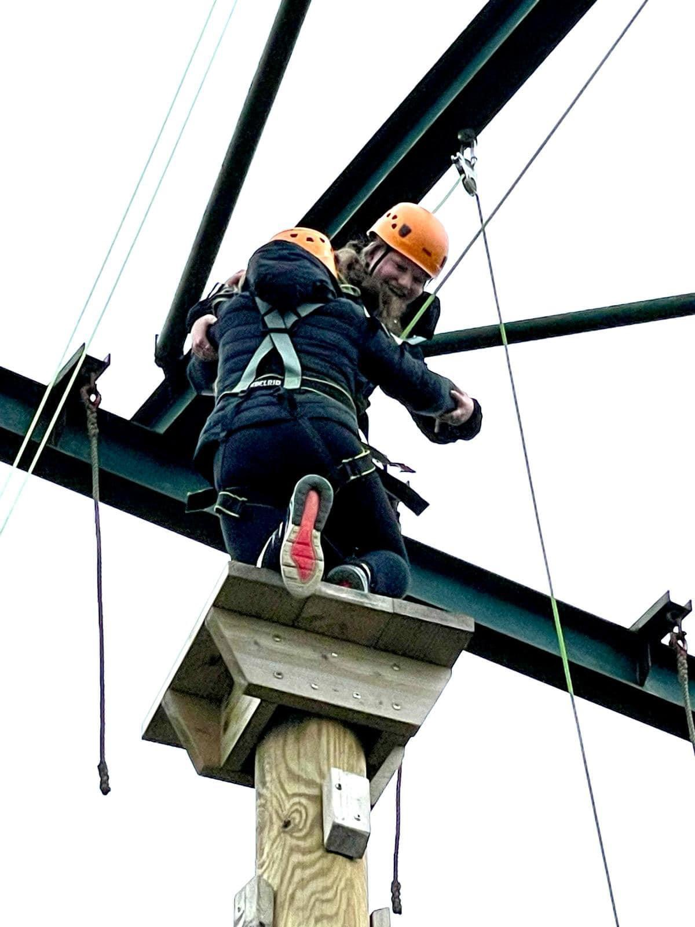
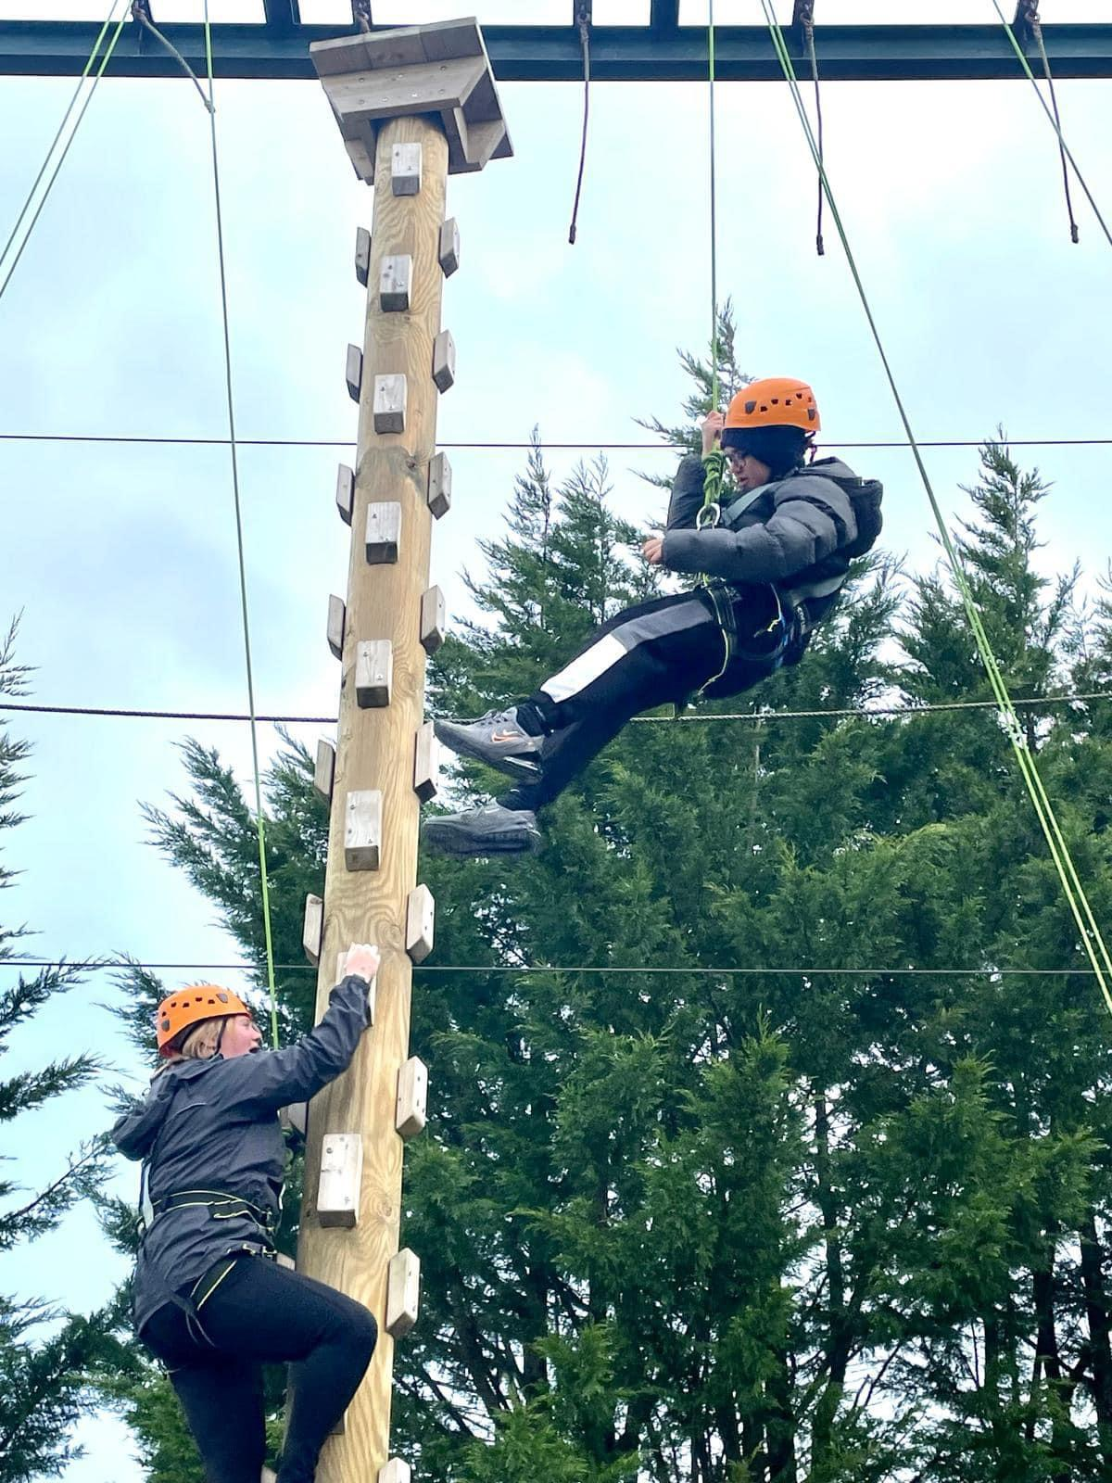

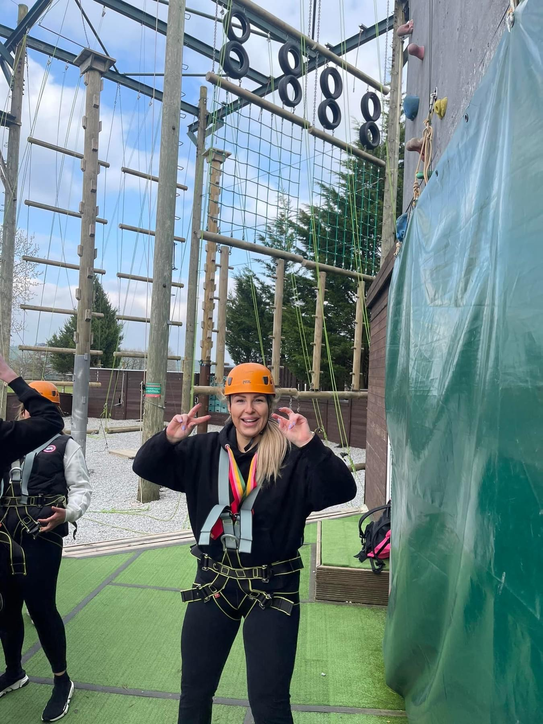
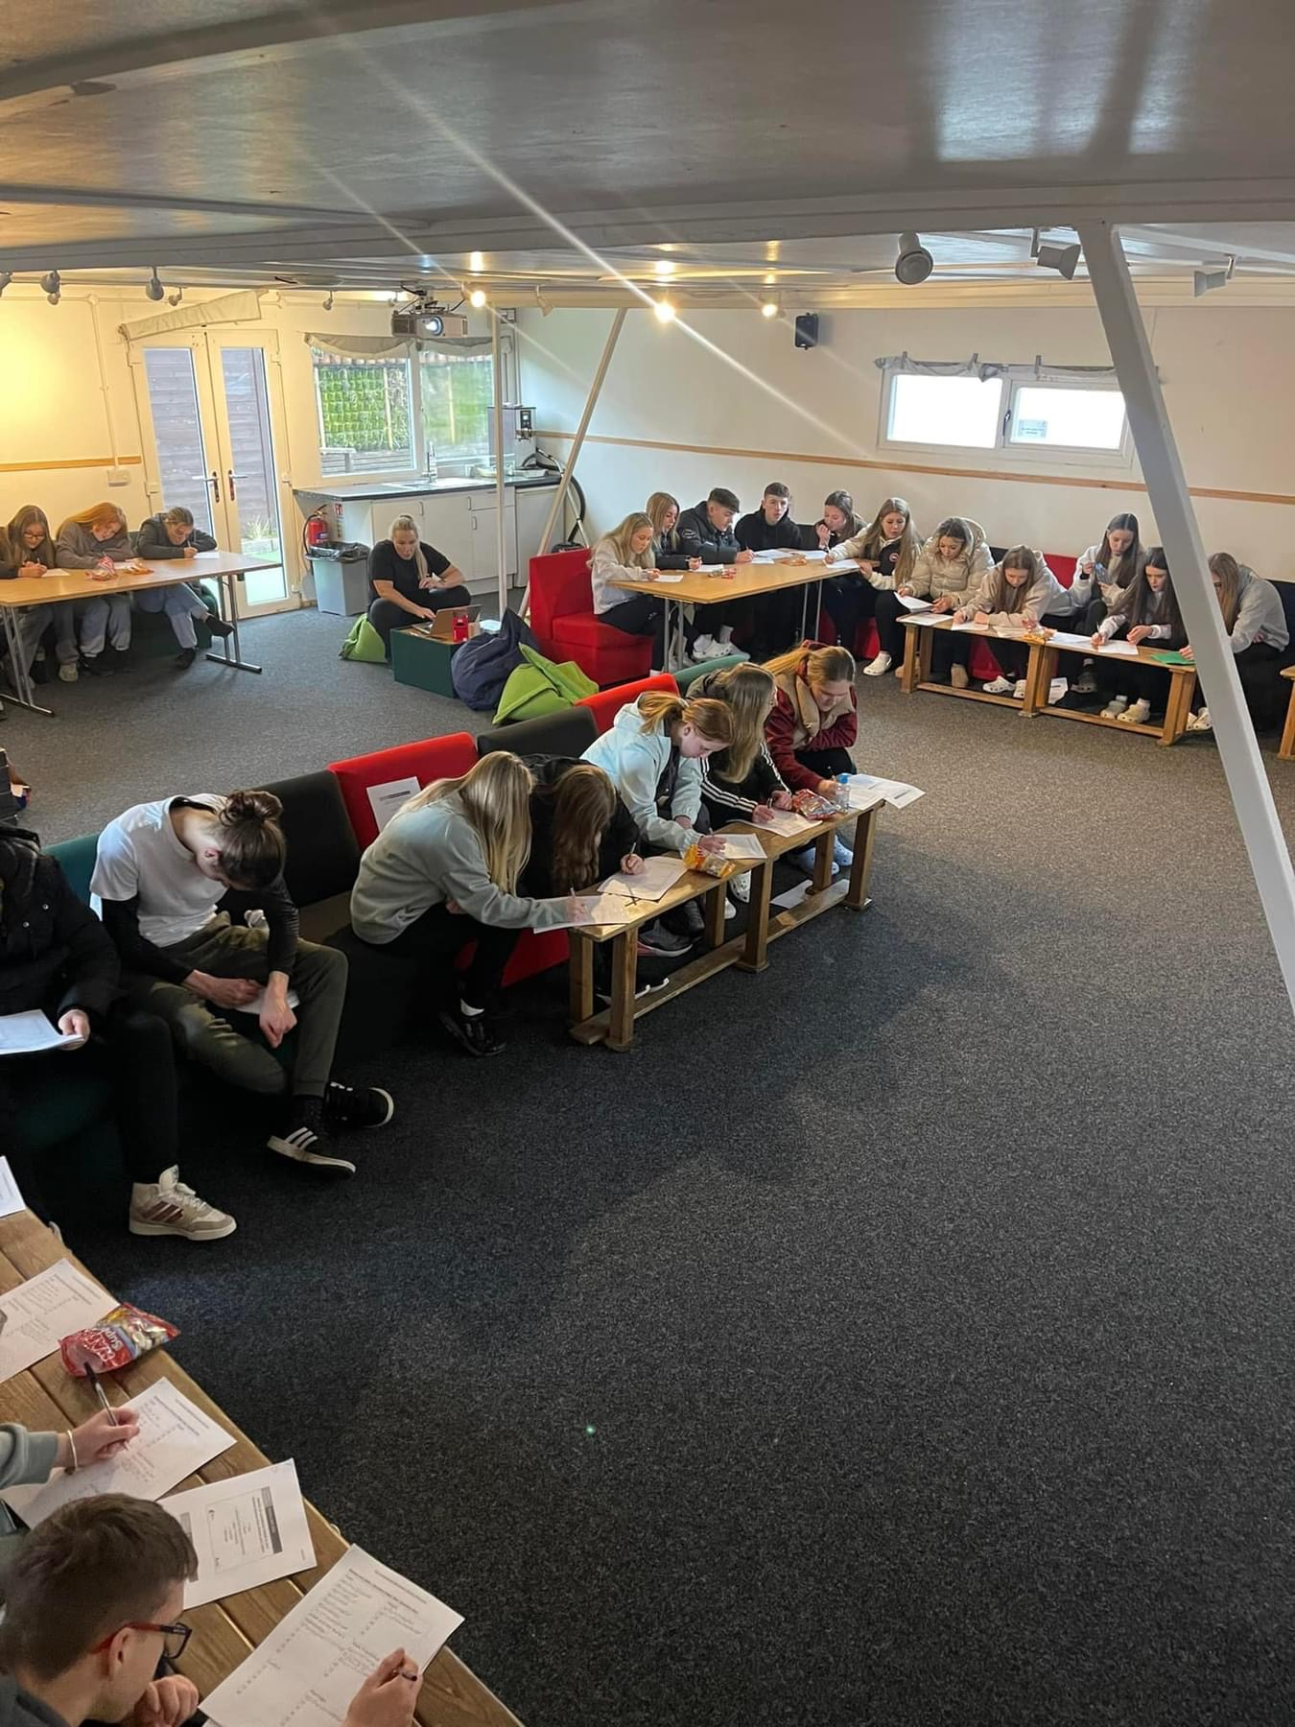

Slide 20
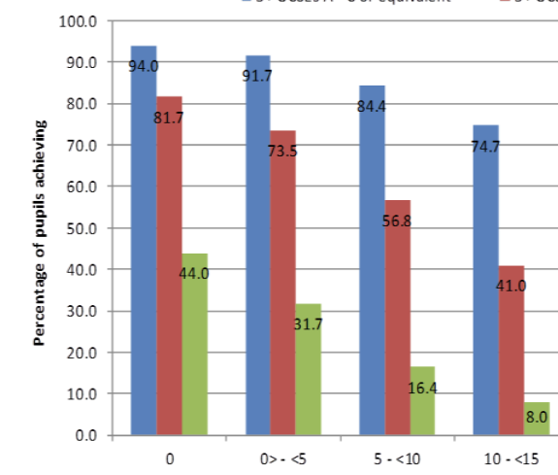
Attendance
“Among pupils with no missed sessions over KS4, 83.7% achieved grades 9 to 4 in English and maths compared to 35.6% of pupils who were persistently absent.”
Two days a month = 10% of the school year.
“You can't achieve your dreams if you don't turn up to chase them.”

Slide 21

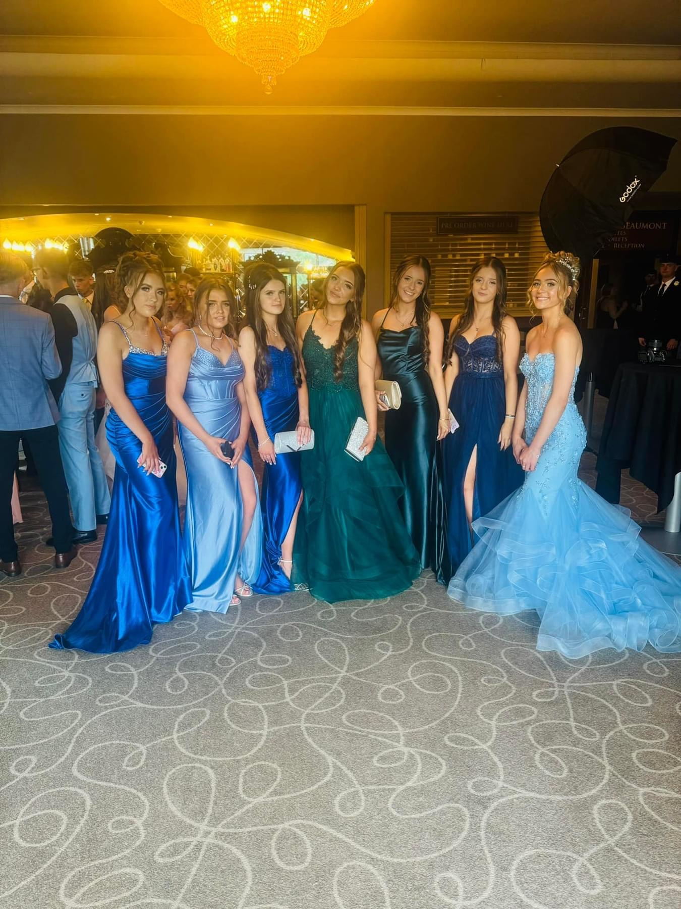
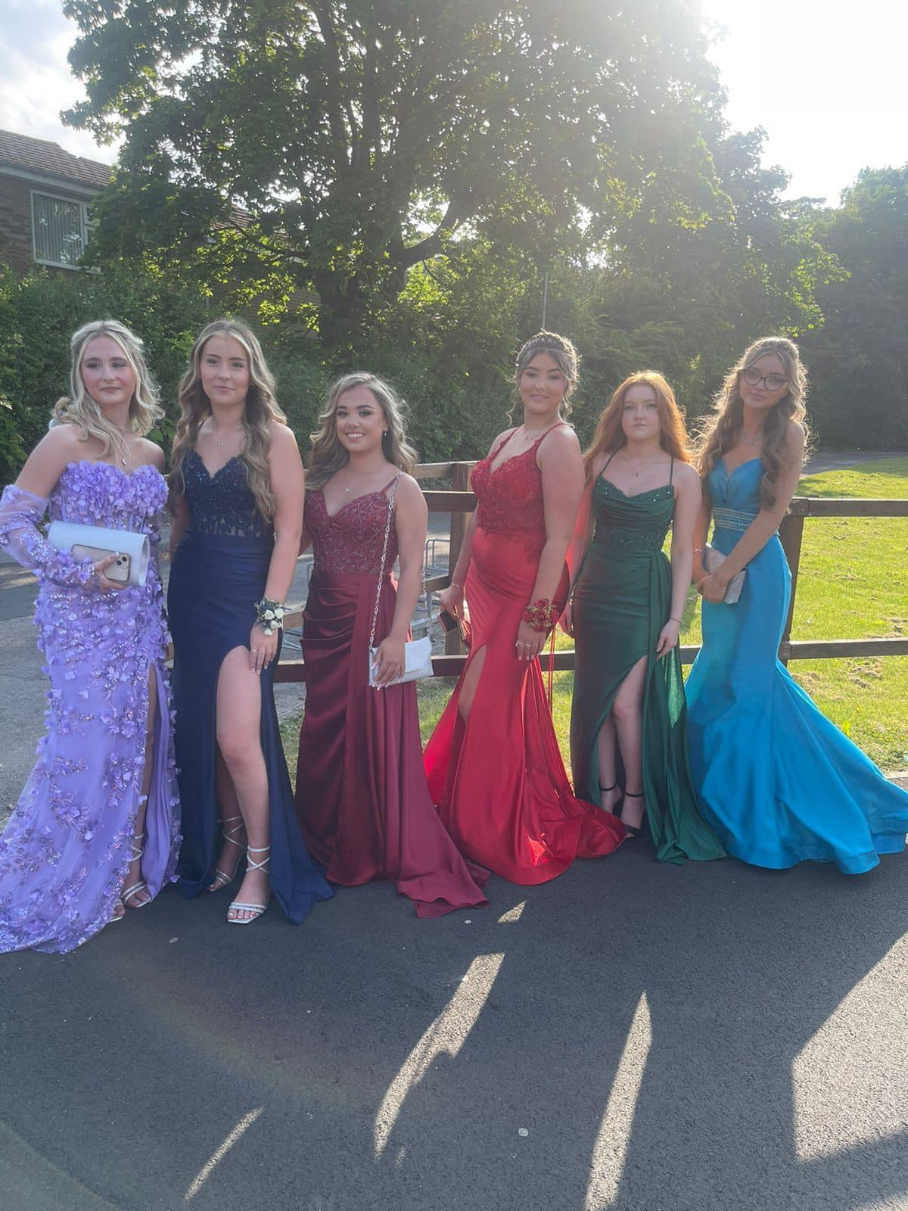
Prom passport

Slide 22
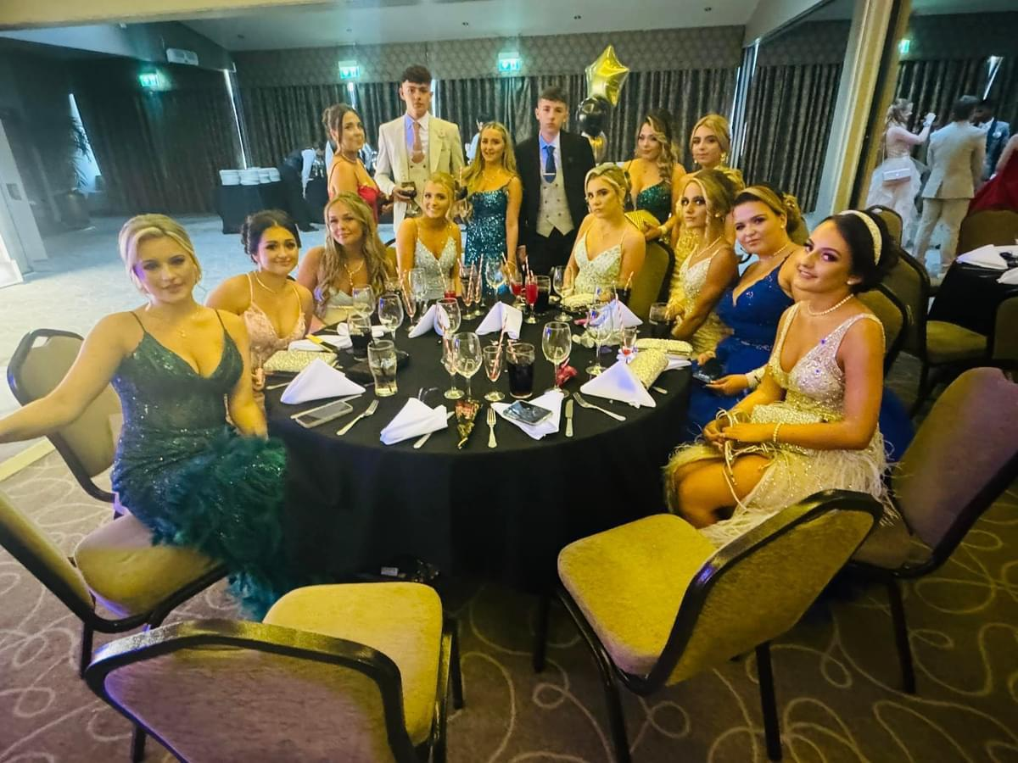

Slide 23
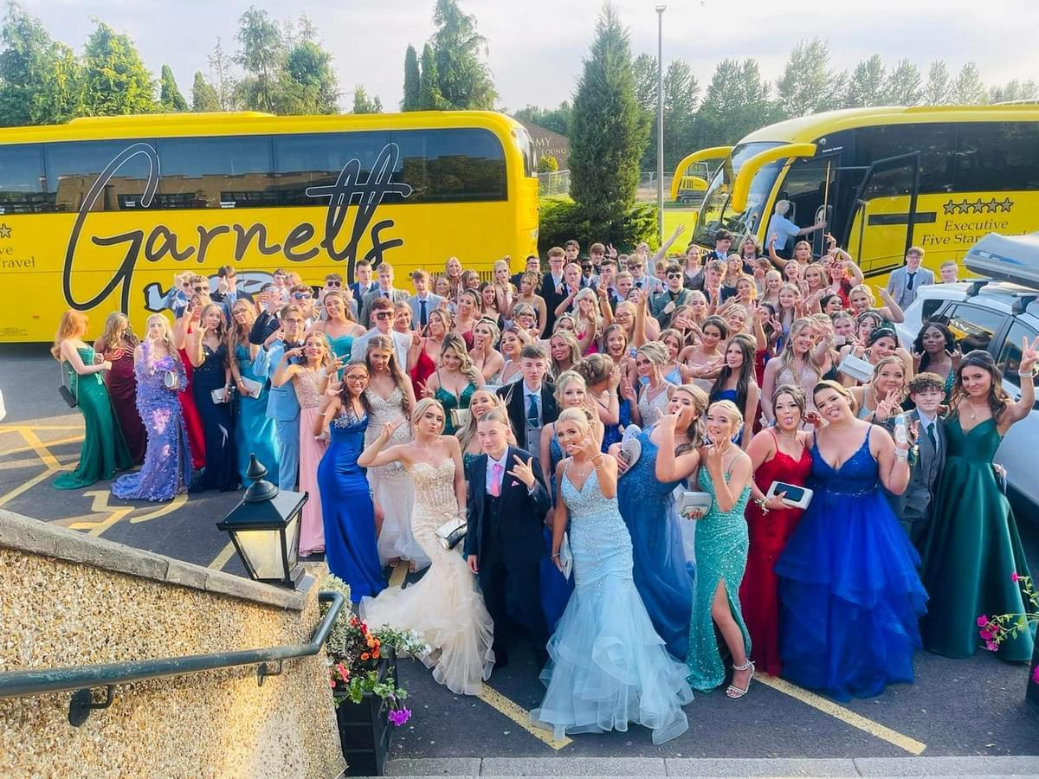

Slide 24

Enrichment
Academic Enrichment
Library - Monday - Thursday
GCSE History - Monday/Wednesday
GCSE Food/Health and Social care/Child Development catch up - Monday
Y11 Revision Cafe - Monday
Maths Homework - Monday
GCSE Geography - Tuesday
GCSE Biology- Tuesday
Further Maths - Wednesday
Y11 Physics - Friday
Notes:
Without a doubt, it takes all of the caring adults in a Student's life working together to effectively foster and nurture a students’s overall development.
This is the power of triangulation in its most positive context – teacher, parent, and child coming together in ways that significantly impact the child’s development, attitude toward learning, academic performance, self-confidence, and relationships with others.

Slide 25

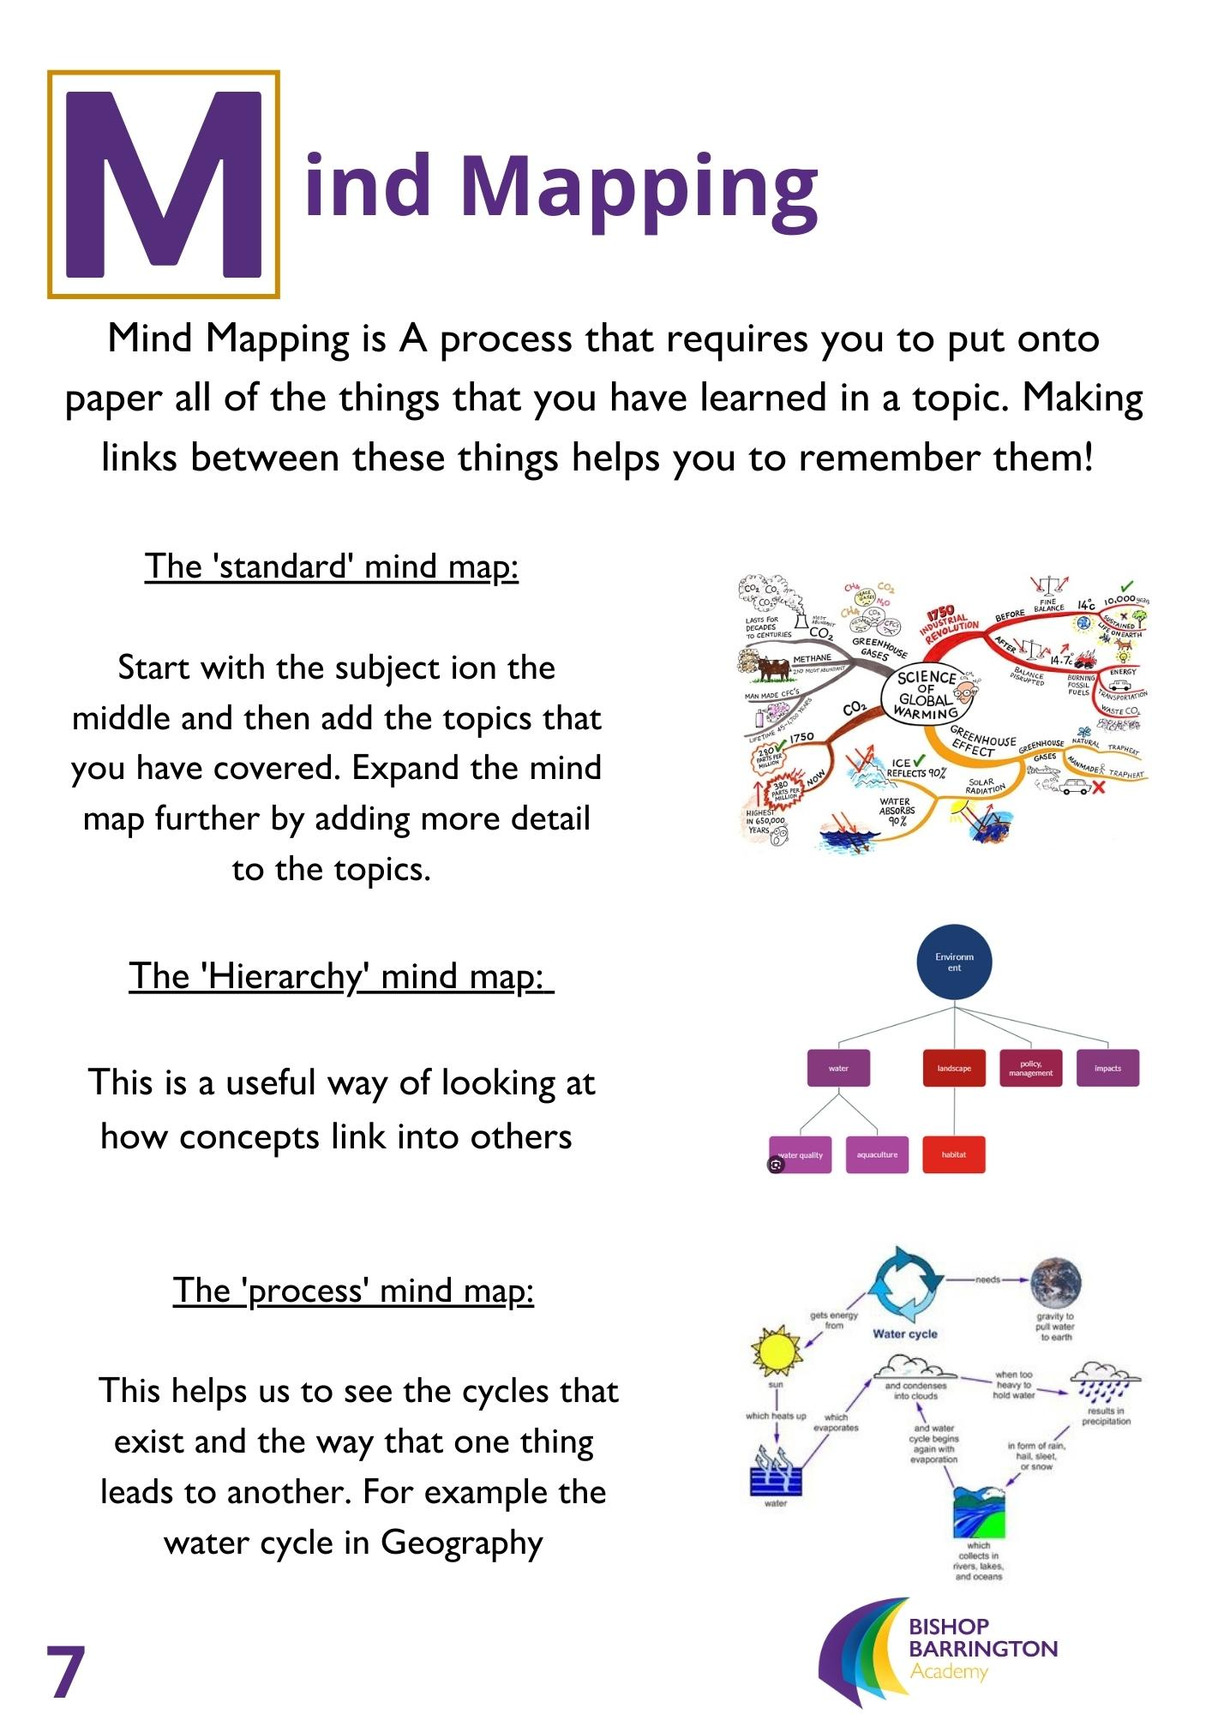
Revision is the Key

Slide 26
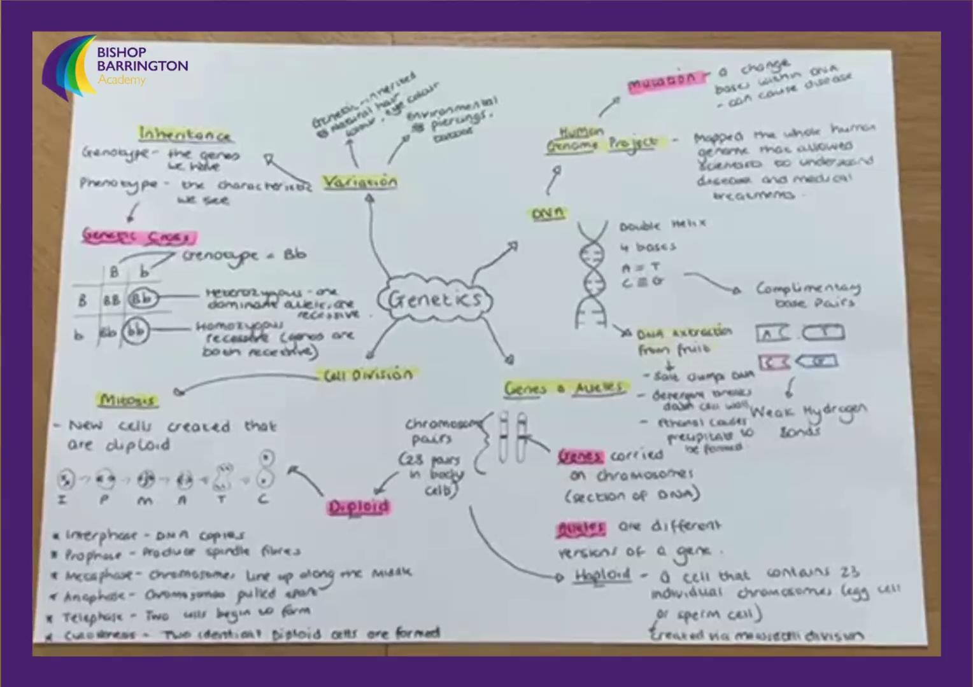
Mind Mapping

Slide 27
Key Dates
Oct Half Term Intervention - Mon 28th Oct - Fri 1st Nov
Mock series 1: Wednesday 6th November
Mock results and careers fayre: Thursday 12th December
Mock series 2: January 13th - 24th
Feb Half Term Intervention - Mon 24th Feb - Fri 28th Feb
Revision Residential - March 8/9th
Easter Half Term Intervention - Mon 14th April - 25th April
Parents Evening - Thursday 3rd April
Provisional GCSE’s - Monday 5th May* - June 20th*
Prom - TBC

Slide 28
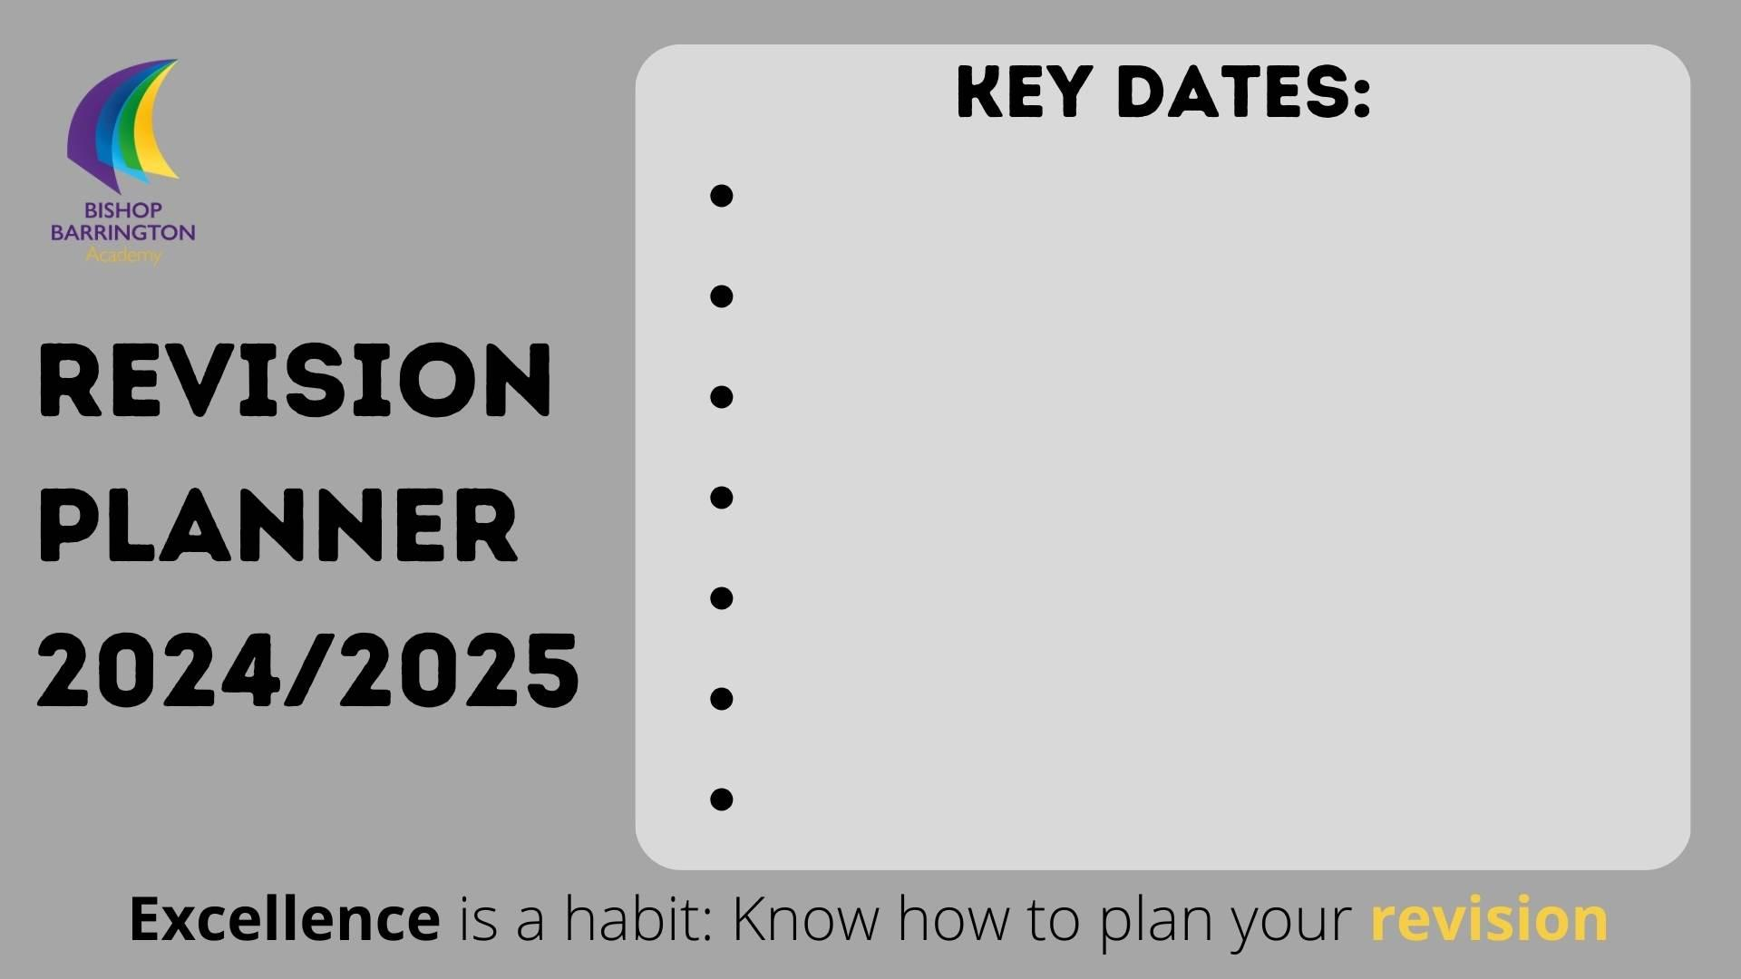
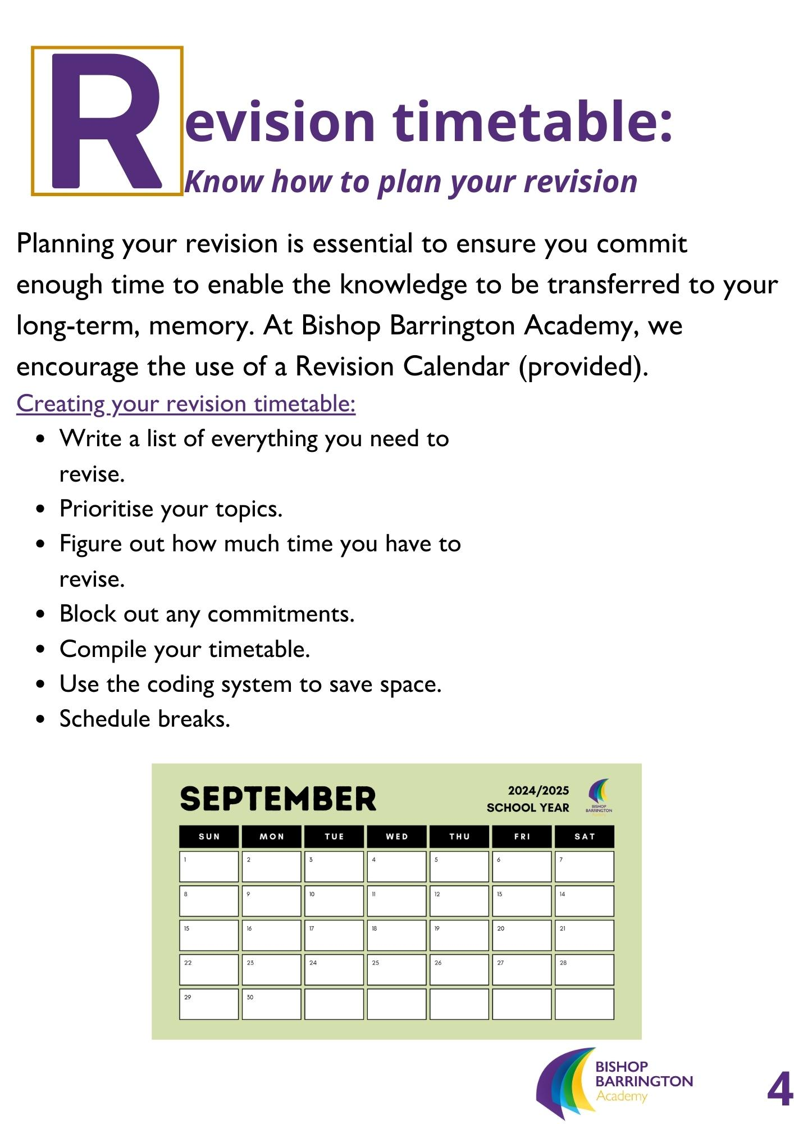
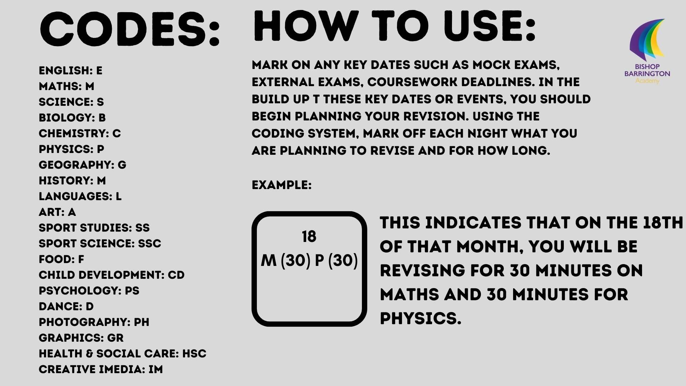
Planning Revision

Slide 29
Support & Help
We understand with the pressures of Year 11, comes some worries and concerns.
Seek Support from:
Form Tutor
Year Leader
Subject specialists
Friends and family
We are all in this together with you!
Notes:
Without a doubt, it takes all of the caring adults in a Student's life working together to effectively foster and nurture a students’s overall development.
This is the power of triangulation in its most positive context – teacher, parent/carer and Student coming together in ways that significantly impact the Student’s development, attitude toward learning, academic performance, self-confidence, and relationships with others.
Our students have a network of staff behind them with a wealth of knowledge and experience them through what will be at times a rollercoaster of emotions.
Their first port of call is their form tutor. We have placed some of our most experienced form tutors in year 11 to ensure they receive the best support.
Should they require specific subject support as well as their class teacher students can speak to subject leaders

Slide 30
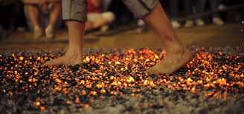

Whatever it takes

Slide 31
English
Ms Greenup - Subject Leader of English

Slide 32
English Literature - Course Content
AQA Course
Paper 1 - 64 marks 40%
1 hour 45 minutes
Romeo and Juliet
and A Christmas Carol
Paper 2 - 96 marks 60%
2 hours 15 minutes
An Inspector Calls, Conflict Poetry,
Unseen Poetry Question and an Unseen Poetry Comparison Question.
Texts:
Paper 1 - Romeo and Juliet and A Christmas Carol
Paper 2 - An Inspector Calls and Power and Conflict Poetry.

Slide 33



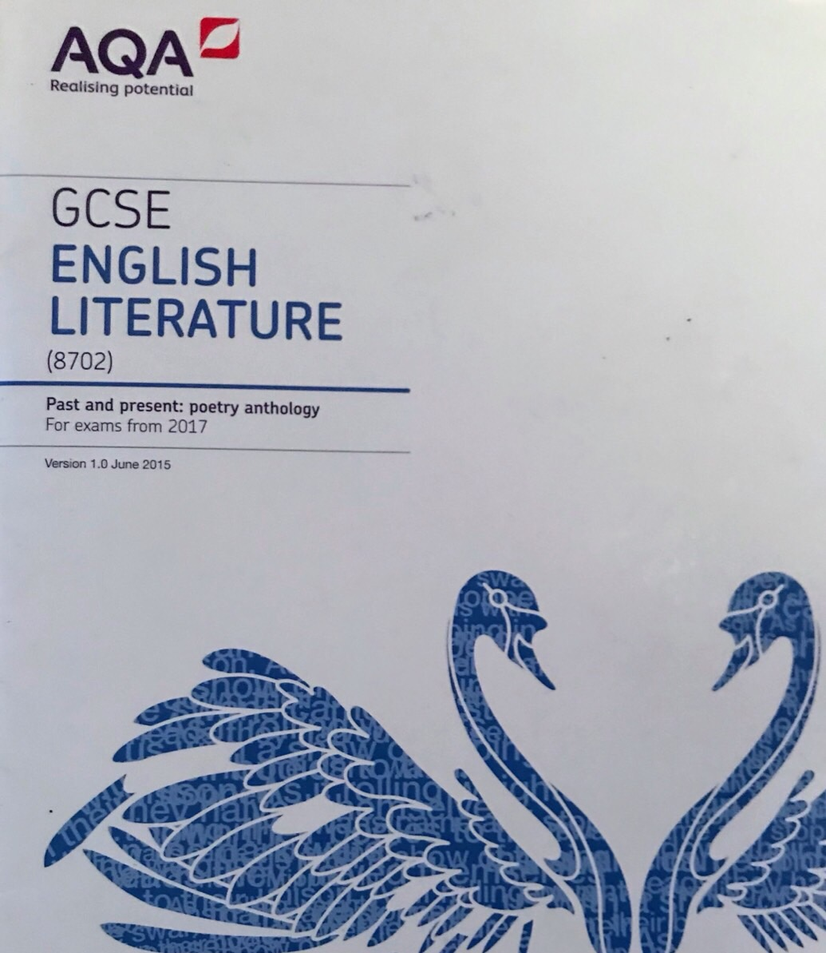
English Literature - Tips to Success
Students will need to revise key quotations for key themes and characters from Romeo and Juliet, A Christmas Carol and An Inspector Calls.
Students will be expected to know up to 6 quotations for each theme and character.
For the Power and Conflict Poetry, students will be expected to remember up to 3 quotations from each poem.

Slide 34
English Literature - Tips to Success
We have created our own revision guides as a department.
There is one for each of the texts, with all of the key quotations we look at in lessons.
Other ways we suggest you revise include:
Rereading the texts
Revision Clocks
Revision Cards
Practicing PETAL paragraphs
Planning Responses
All English staff are happy to help!

Slide 35
English Language - Course Content
AQA Course
Paper 1 - 80 marks 50%
1 hour 45 minutes
Explorations in creative reading and writing (fiction)
Paper 2 - 80 marks 50%
1 hour 45 minutes
Writers’ viewpoints and perspectives (non-fiction)
Both papers:
Reading Section: 4 questions, 40 marks
Writing Section: 1 question, 40 marks

Slide 36
English Language - Tips to Success
Some of the best ways to revise:
Using revision cards.
Reading a wide range of extracts (fiction and non-fiction).
Practicing planning exam questions – particularly section B on both writing papers.
We have made a revision guide for the language papers, as well as the Literature texts.
This includes all of the structures we use in lessons.

Slide 37
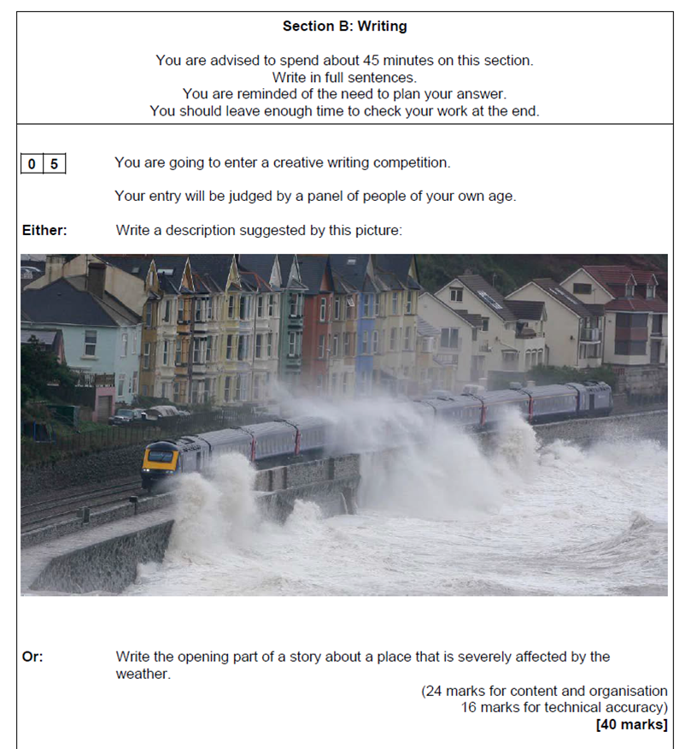
English Language - Exam Question Example
Students need to learn the key skills required for each question.
Students need to know the focus of each of the five language questions (for each paper).

Slide 38
English - Questions & Answers
Is there any coursework?
No. There is no coursework - the grade is based entirely on exams.
Which texts are studied?
Romeo and Juliet , A Christmas Carol, An Inspector Calls and Power and Conflict Poetry.
How can my child revise for the English courses?
Practice, practice, practice: skills between the two courses are the same (analysis of language, structure and comparing texts). Reading helps too.
Why is English important?
No matter what your child’s plans are for the future a grade 4 is expected in English for most courses and apprenticeships. They will learn and develop vital skills such as speaking, listening and writing.

Slide 39
Maths
Mr Dobson - Lead Practitioner of Maths (KS4)

Slide 40
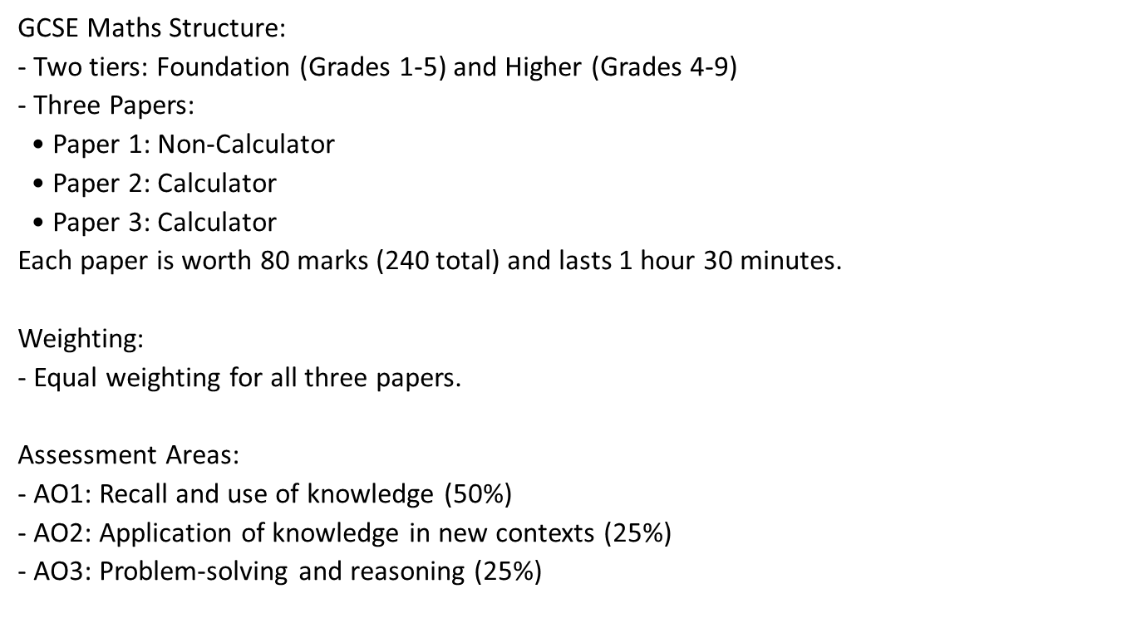
Overview of the Edexcel Maths Exam

Slide 41
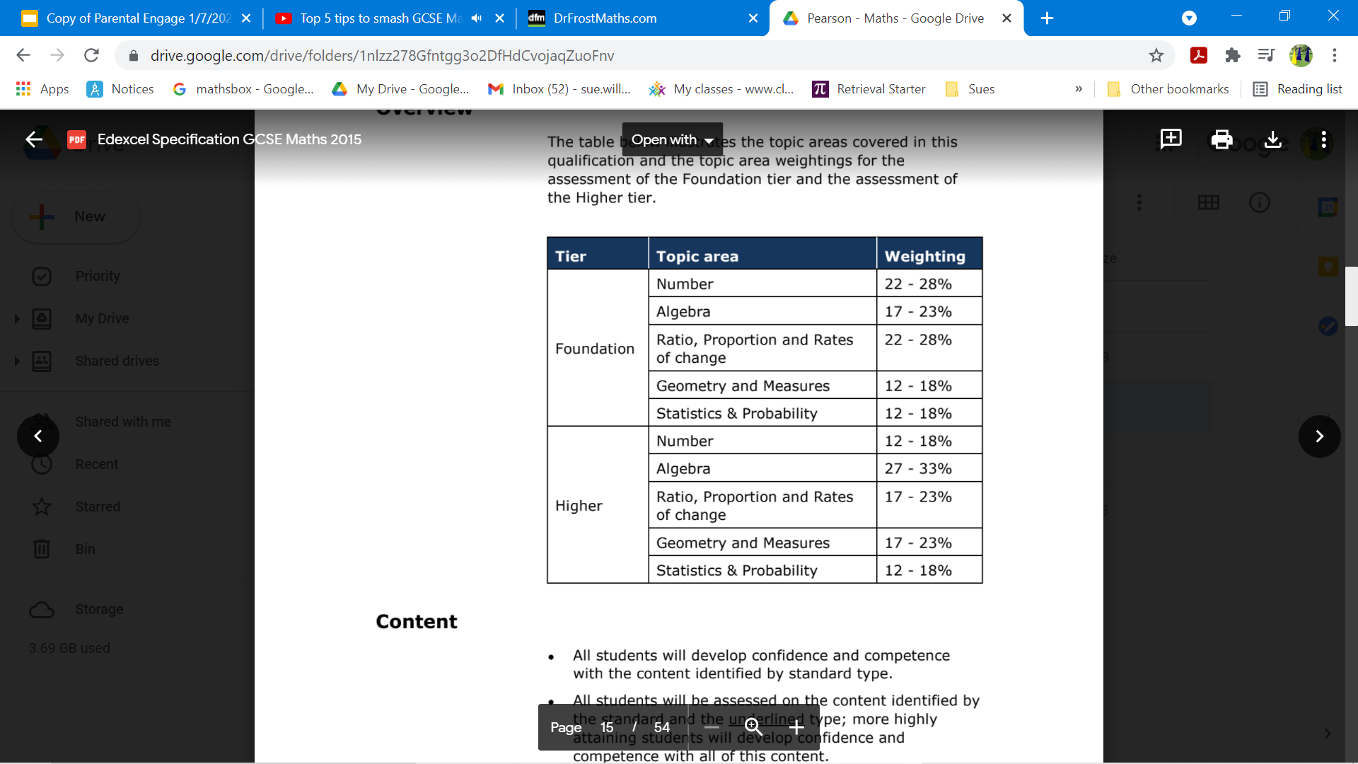
Maths - Course Content
Notes:
Previous past paper grade boundaries easily located on mathsbot

Slide 42

Maths - Revision Resources
CorbettMaths Revision Cards:
High quality flash cards
93 cards which each feature a different topic
Each card features key information, QR codes to videos, exam questions and answers to exam questions
Students will group cards into priority sections to target their revision
Notes:
Value- don’t say-”It’s ok I couldn’t do maths either/ I’m rubbish at maths” etc- we all want our children to be more successful than we were. Instead say “I found it tricky but with support you can do this”- give parents a narrative
We learn by making mistakes & acting on them
Know

Slide 43
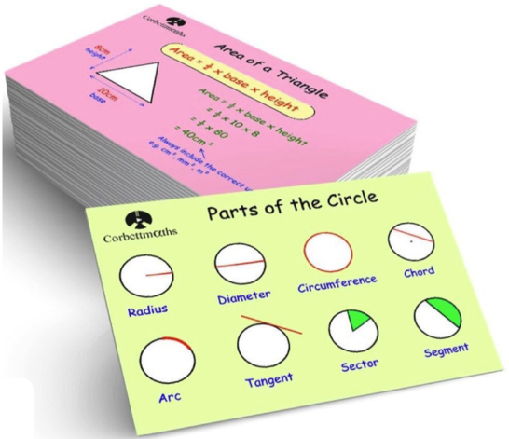
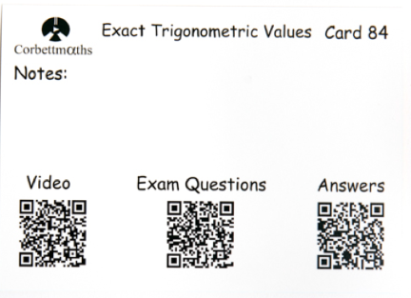
Maths - Revision Resources
CorbettMaths Revision Cards:
Notes:
Value- don’t say-”It’s ok I couldn’t do maths either/ I’m rubbish at maths” etc- we all want our children to be more successful than we were. Instead say “I found it tricky but with support you can do this”- give parents a narrative
We learn by making mistakes & acting on them
Know

Slide 44

Maths - Revision Resources
MathsGenie Website:
Website filled with exam questions
Search for individual topics or select topics based on their grade
Full worked answers are available for each topic
Full list of past edexcel exam papers with video and worked solutions
Notes:
Value- don’t say-”It’s ok I couldn’t do maths either/ I’m rubbish at maths” etc- we all want our children to be more successful than we were. Instead say “I found it tricky but with support you can do this”- give parents a narrative
We learn by making mistakes & acting on them
Know

Slide 45
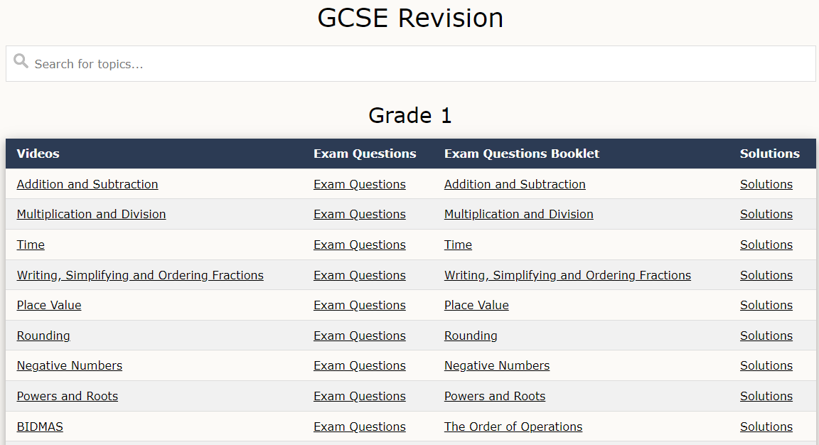
Maths - Revision Resources
Notes:
Value- don’t say-”It’s ok I couldn’t do maths either/ I’m rubbish at maths” etc- we all want our children to be more successful than we were. Instead say “I found it tricky but with support you can do this”- give parents a narrative
We learn by making mistakes & acting on them
Know

Slide 46
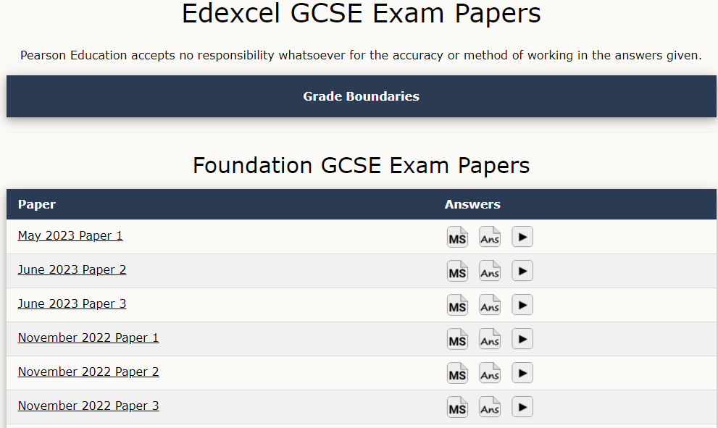
Maths - Revision Resources
Notes:
Value- don’t say-”It’s ok I couldn’t do maths either/ I’m rubbish at maths” etc- we all want our children to be more successful than we were. Instead say “I found it tricky but with support you can do this”- give parents a narrative
We learn by making mistakes & acting on them
Know

Slide 47
Maths - Revision Resources
QLAs:
List of topics prioritised and tailored for each student
Based on answers to mock exam
All topics highlighted in red, amber or green
Each student will receive a copy after each mock
Notes:
Value- don’t say-”It’s ok I couldn’t do maths either/ I’m rubbish at maths” etc- we all want our children to be more successful than we were. Instead say “I found it tricky but with support you can do this”- give parents a narrative
We learn by making mistakes & acting on them
Know

Slide 48
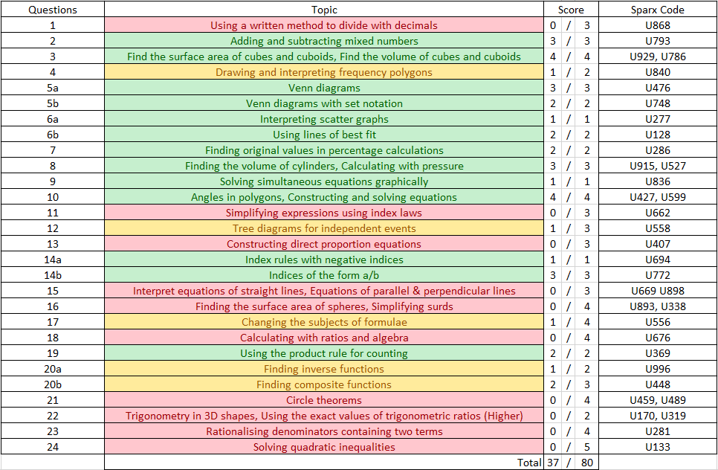
Maths - Revision Resources
QLAs:
Notes:
Value- don’t say-”It’s ok I couldn’t do maths either/ I’m rubbish at maths” etc- we all want our children to be more successful than we were. Instead say “I found it tricky but with support you can do this”- give parents a narrative
We learn by making mistakes & acting on them
Know

Slide 49
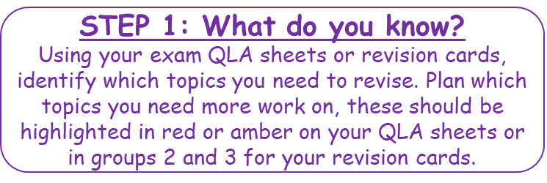
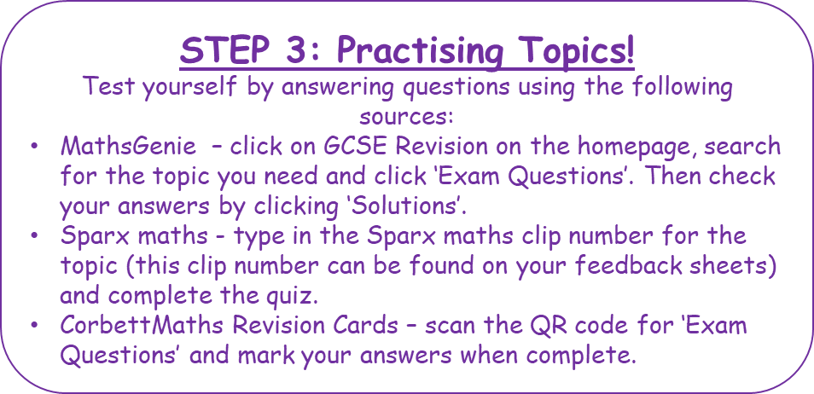


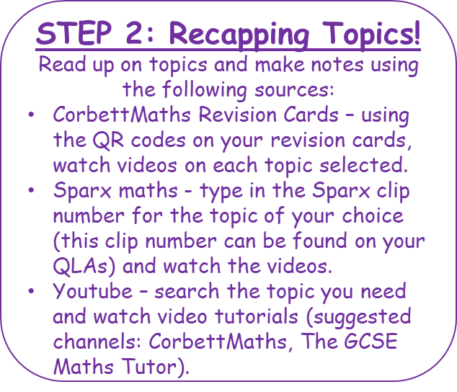
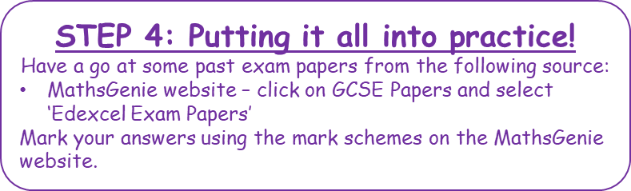
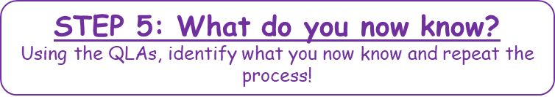
Maths - Tips to Success
Notes:
Value- don’t say-”It’s ok I couldn’t do maths either/ I’m rubbish at maths” etc- we all want our children to be more successful than we were. Instead say “I found it tricky but with support you can do this”- give parents a narrative
We learn by making mistakes & acting on them
Know

Slide 50
Maths - Questions & Answers
How much homework should my child be doing in maths?
Homework will be set once a week and your child should be doing between 40 and 60 minutes
Why does my child need GCSE maths?
Maths underpins so many areas of everyday life as well as supporting learning in other fields.
GCSE maths at grade 4 or above is needed for many post 16 courses and all university courses, and your child will continue to study maths at college if they do not achieve this at the end of year 11
Which tier of entry will my child be on?
Your child should already know if they are sitting the higher or foundation paper, the final decision for this will be made after the first round of mock exams
Who should my child speak to if they need extra support?
Their teacher! :)
Notes:
Any questions already sent in?

Slide 51
Science
Mr Galvin - Head of Science Department

Slide 52
Science - Course Content - Edexcel combined science
Each of the three sciences are taught by specialist teachers.
Physics topics include...
Conservation of energy
Radioactivity
Electricity and circuits
Magnetism and the motor effect
2 x GCSE’s awarded
6 exams at the end of year 11
2 x 1hr 10min papers for each of biology, chemistry and physics
Chemistry topics include...
Acids and alkalis
Earth and atmospheric sciences
Rates of reaction
Obtaining and using metals
Foundation and higher tier
Biology topics include...
Natural selection and genetic modification
Health, disease and the development of medicines
Ecosystems and materials sciences

Slide 53
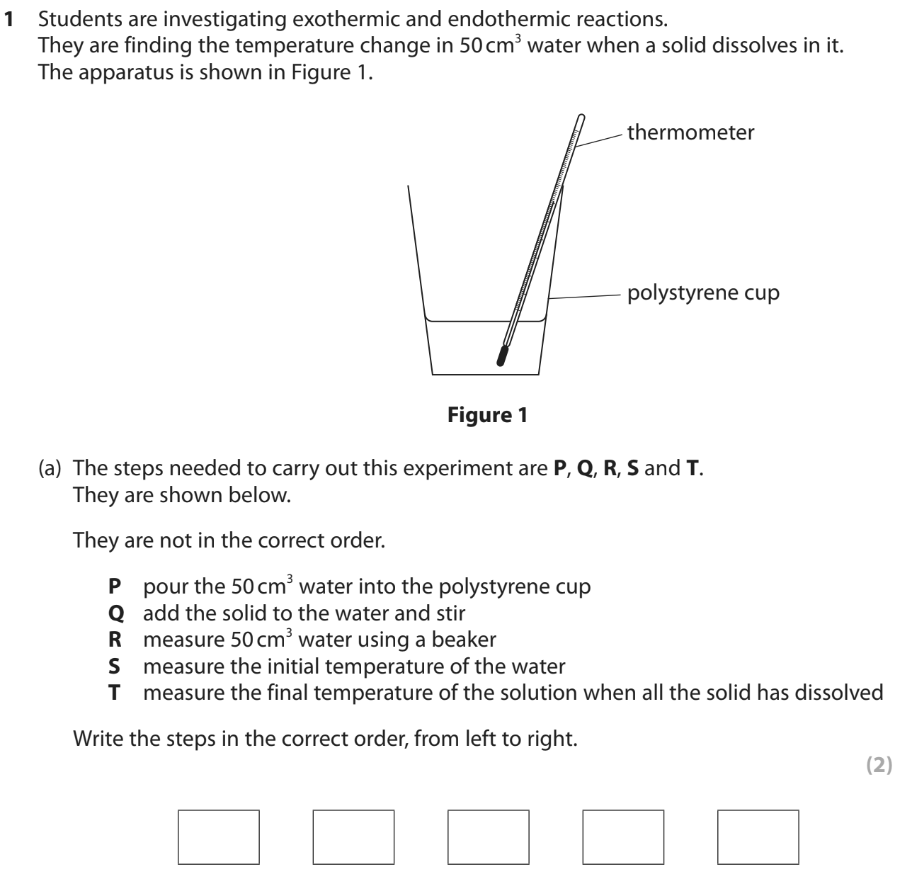
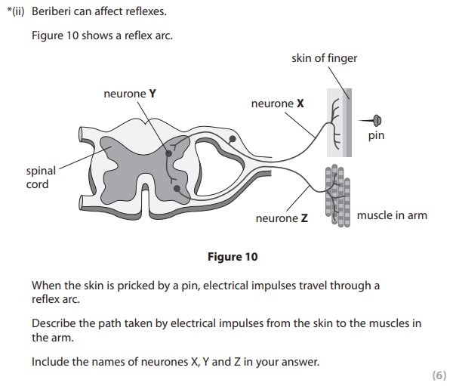
Science- Exam Paper Examples

Slide 54
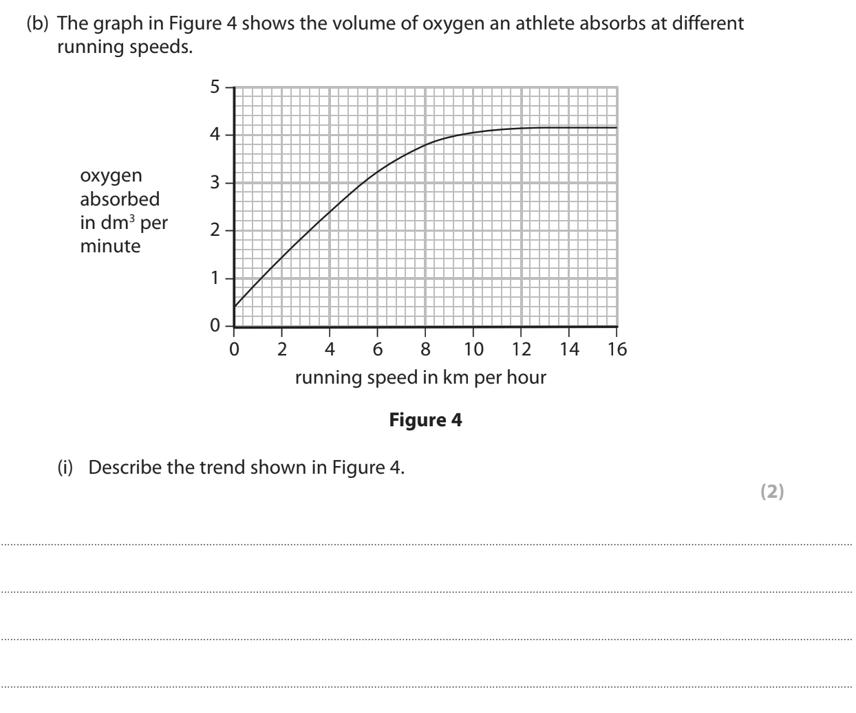
Science- Exam Paper Examples

Slide 55

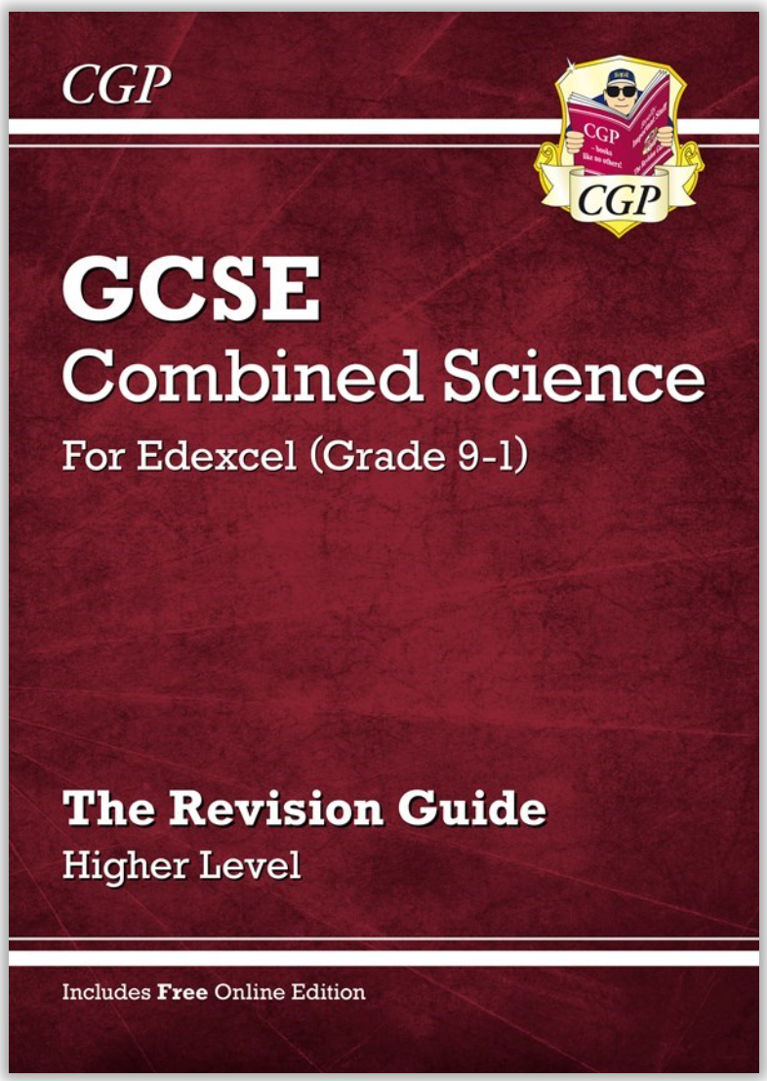

Science- Tips to Success
Work hard
Take an interest in science around you
Practice revising!!!
Reading alone is not revision
Involve others where possible - friends and family can be a great help!!
Free science lessons
Science and maths by primrose kitten
Edexcel pearson UK educators - core practical videos
Ask your teachers for help!!

Slide 56
Science- Tips to Success
Used spaced retrieval.
Condense learning notes for each topic until you have it down to as few words as possible.
Write questions and answers as you revise.
Test yourself and use past exam questions. They are available for you.
Produce mind maps after revising a topic to help link knowledge.
Free science lessons
Science and maths by primrose kitten
Science with Hazel
Do not struggle on your own. Ask your teachers for help!! In school or on google classroom.

Slide 57
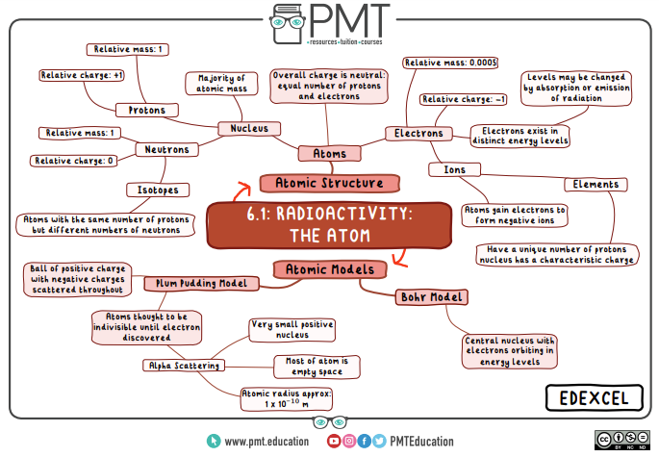
Science- Tips to Success

Slide 58
Science - Questions & Answers
Is there any coursework?
No. There is no coursework - the grade is based entirely on exams.
Do you get a GCSE for each science
For combined science students are awarded 2 GCSE’s based on their performance over the six exams. These are not specific to any of the 3 sciences but include all 3.
For separate sciences yes. Students are awarded 3 GCSE’s, one for each science based on their performance over the 2 exams they sit for that science.
Why do I need to do well in science?
Science will open many doors to colleges, universities or credible alternatives. It will help students develop the skills and knowledge to thrive in top jobs.

