Slide 1
Parent Engagement Evening:
Accelerated Reader
Academic Year 2022-2023

Slide 2
Our Academy Sentence
Bishop Barrington Academy provided the knowledge, skills and qualifications that opened the doors to University or a credible alternative and allowed students to thrive in a top job.

Slide 3
Accelerated Reader
STAR Reader Tests
Accelerated Reader Lessons
Additional reading interventions
Reading Rewards
Students can pick a text they are interested in at their level to encourage success

Slide 4
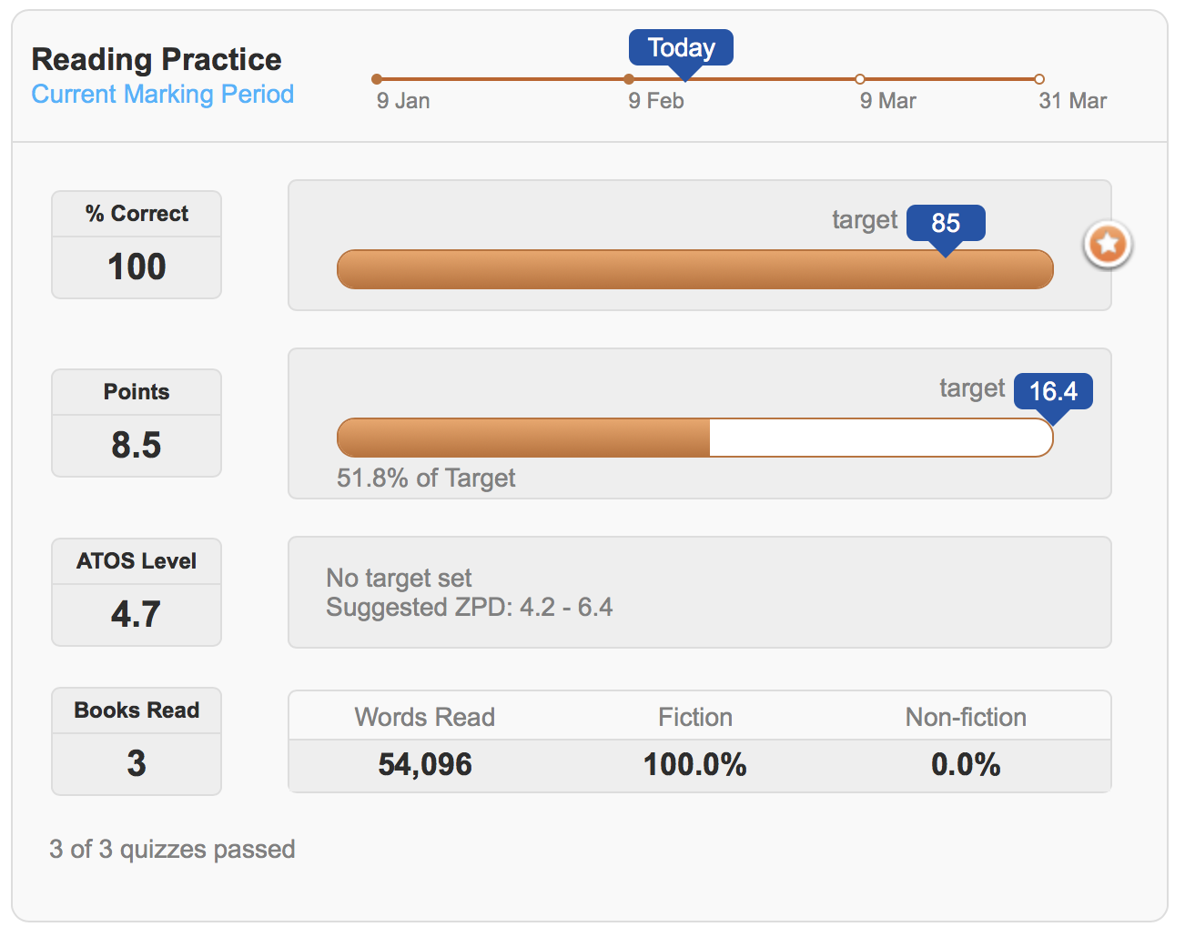
Accelerated Reader: Progress Tracker
Notes:
Students will complete 4 STAR reader tests throughout an academic year.

Slide 5
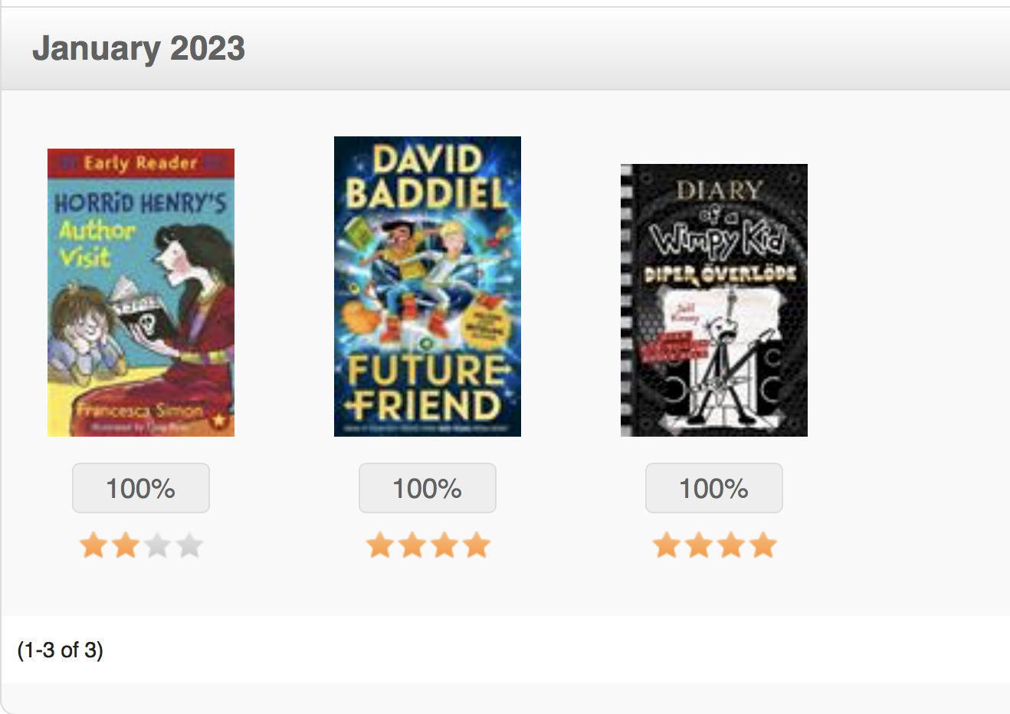
Accelerated Reader: Online Bookshelf
Notes:
Students will complete 4 STAR reader tests throughout an academic year.

Slide 6
How can you help?
Encouraging reading as often as possible at home
Encouraging your child to read anything / everything
Talk about reading
Reading strategies
Having a quiet space / time in the house for reading
Modelling reading
Encouraging 20 minutes of reading, Monday to Friday
Reading to your child
Visiting a local library / signing up for a library card

Slide 7
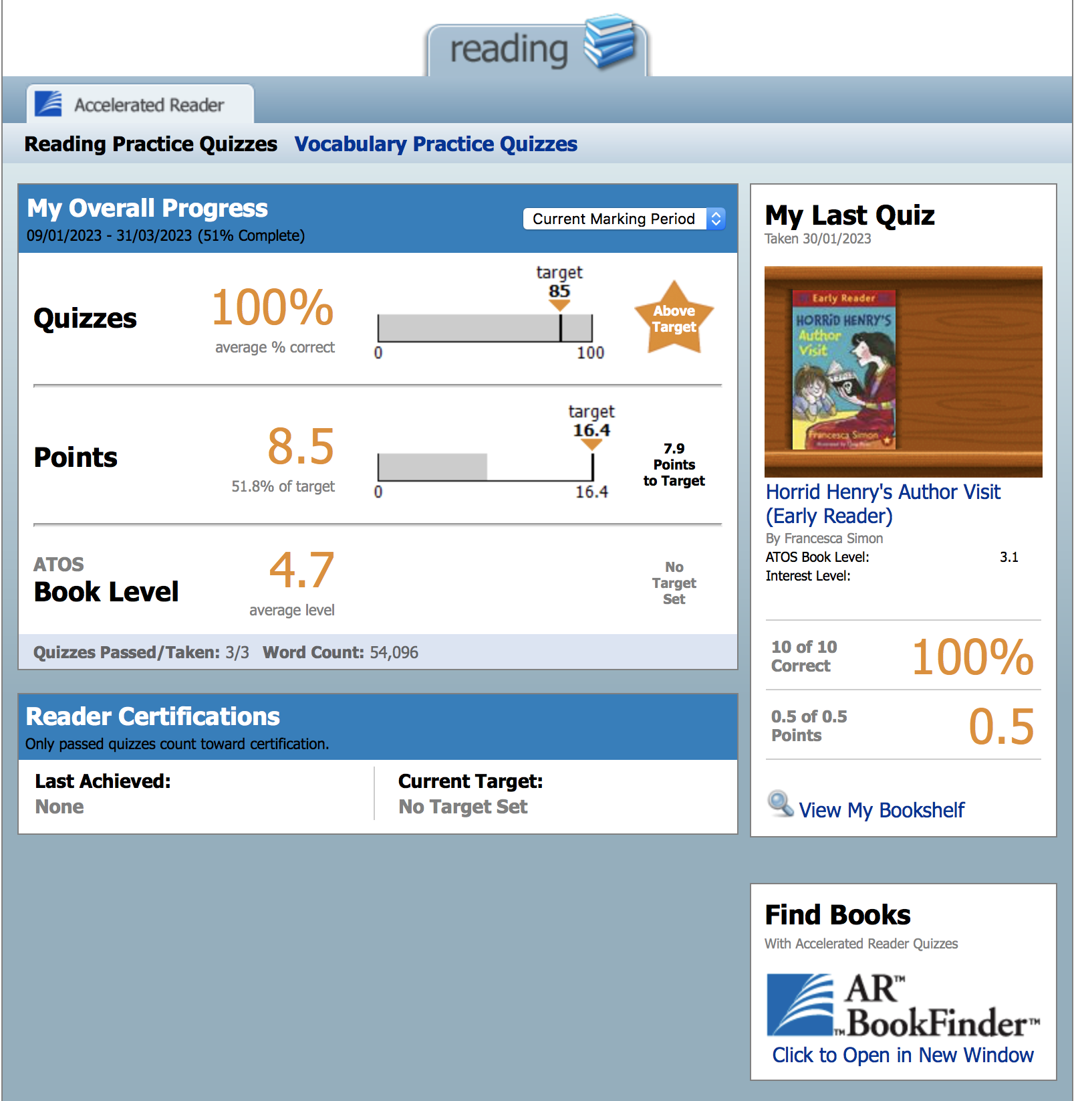
How can you help?
Parents and carers have a separate log in.
This allows you to monitor and track your child’s progress.
If you would like these log in details, please ask a member of staff and we will send this information out to you.

Slide 8
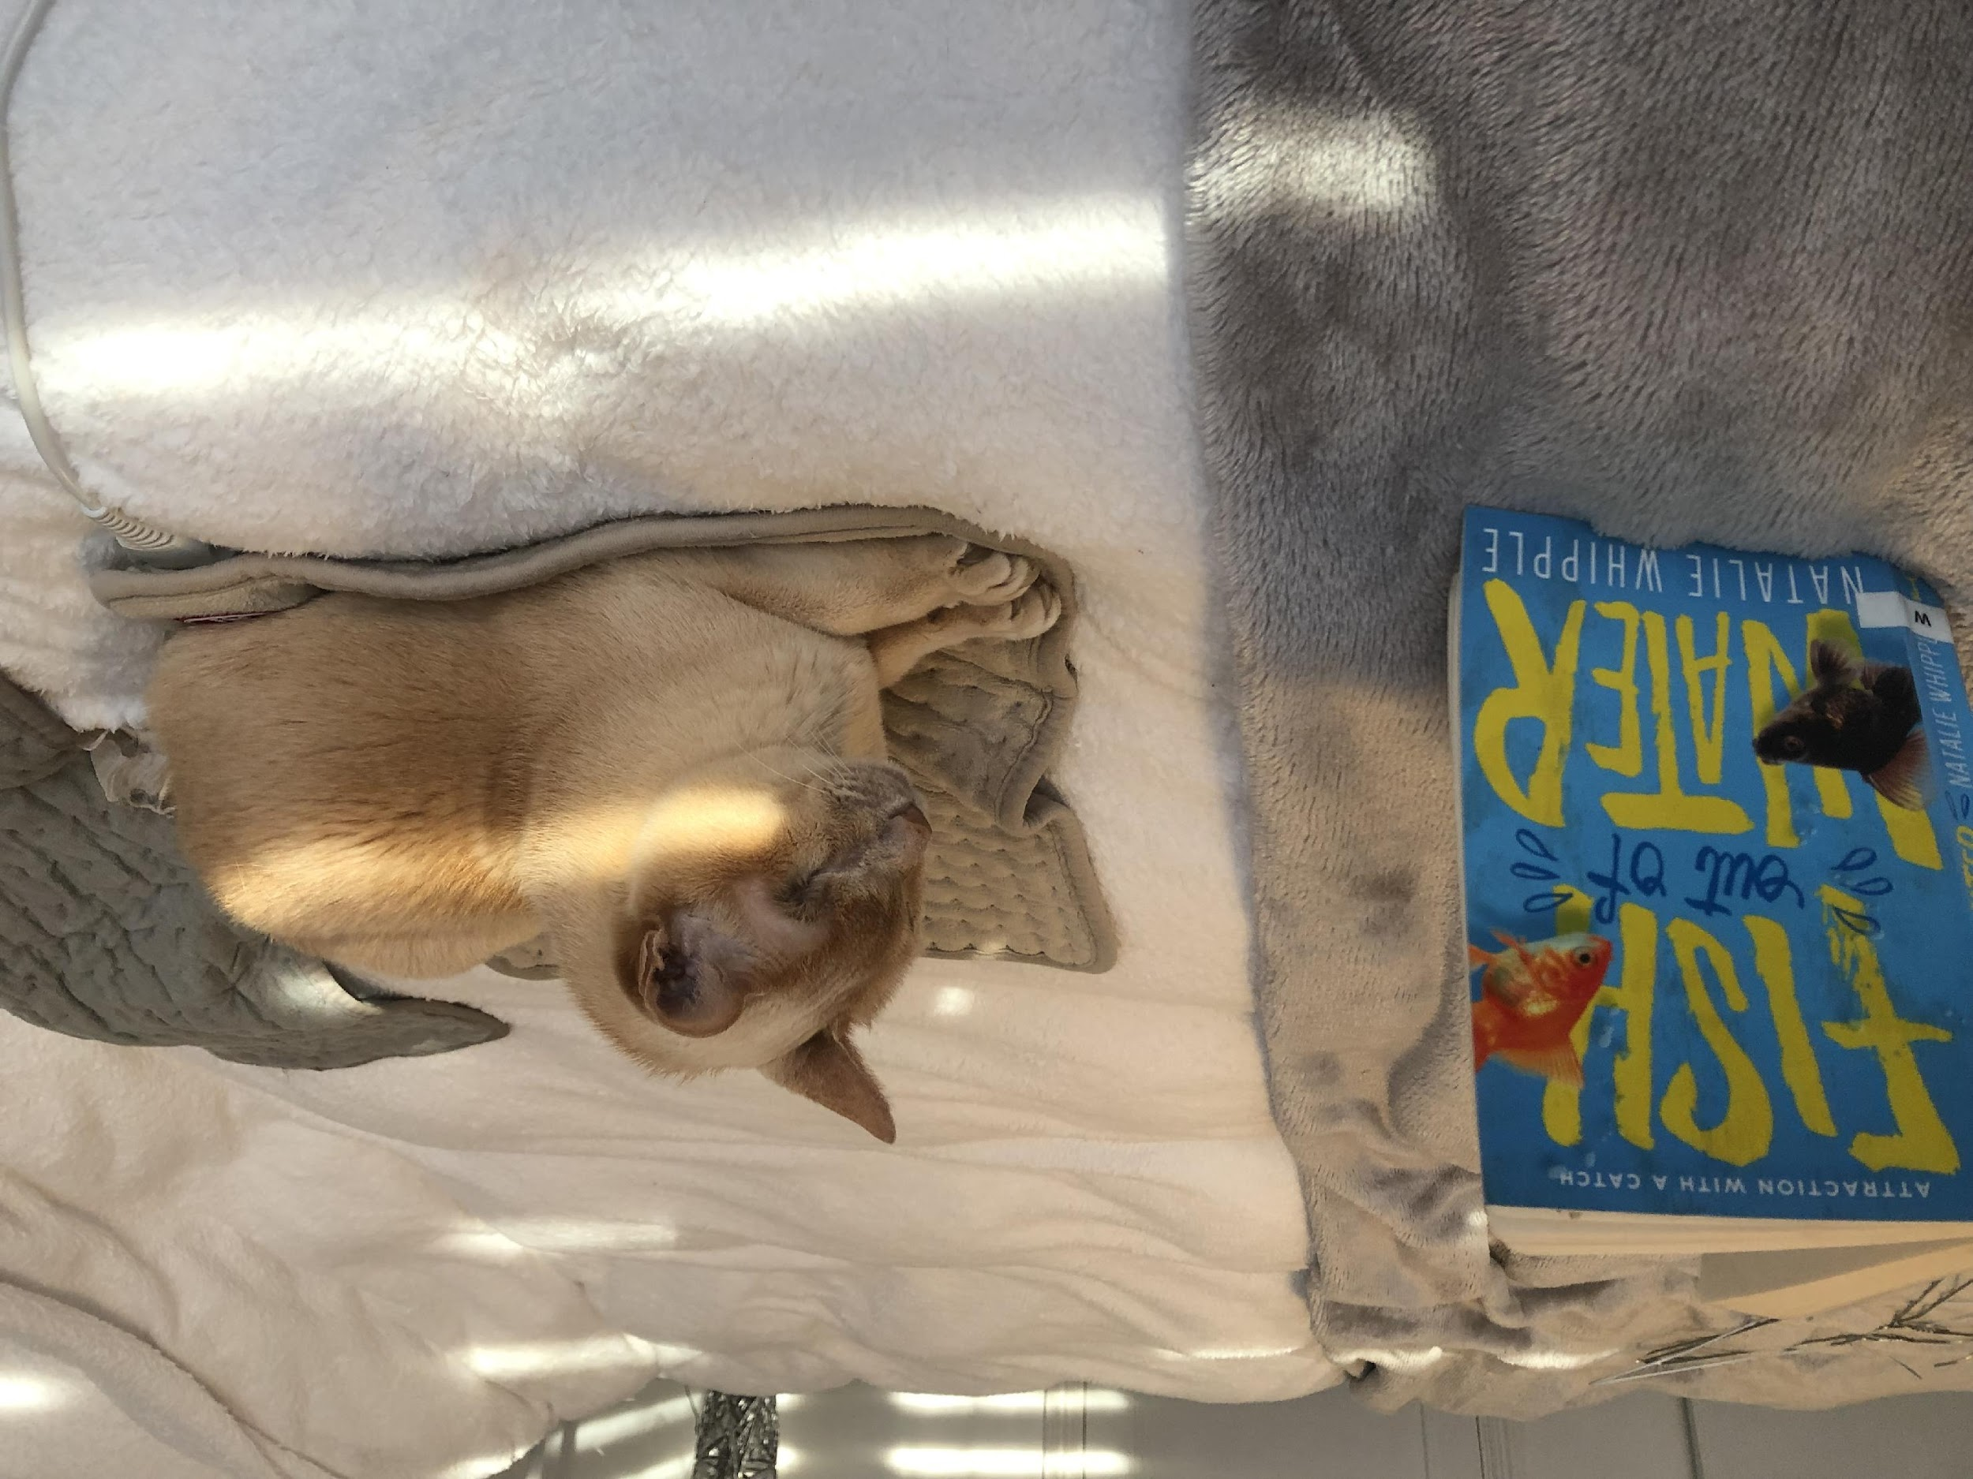
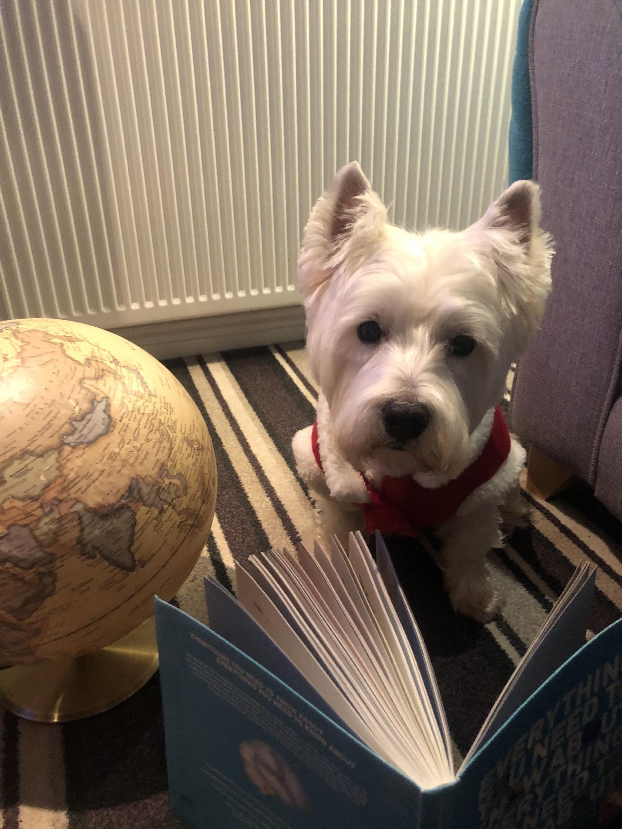
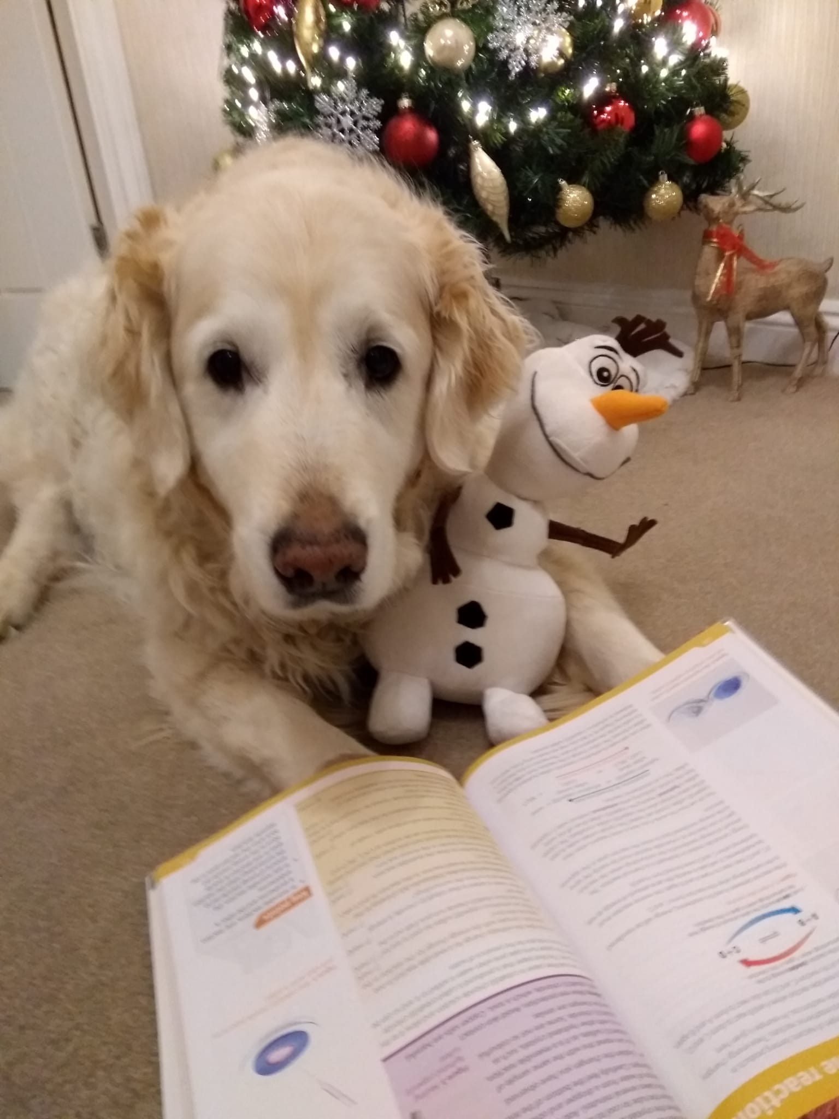
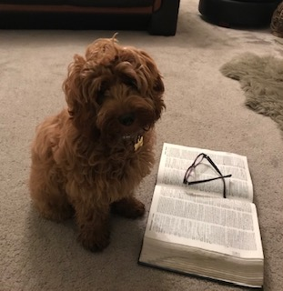
  Promoting Reading in School:
Pets Caught Reading
Students Caught Reading
Reading and Literacy Reward Points
The Bishop Barrington Newspaper
Guided Reading
Student Librarians
Training for Staff with a specific focus on reading
Reading interventions
Library trips
Carnegie Awards Book Club
University Trips, with a focus on reading

Slide 9
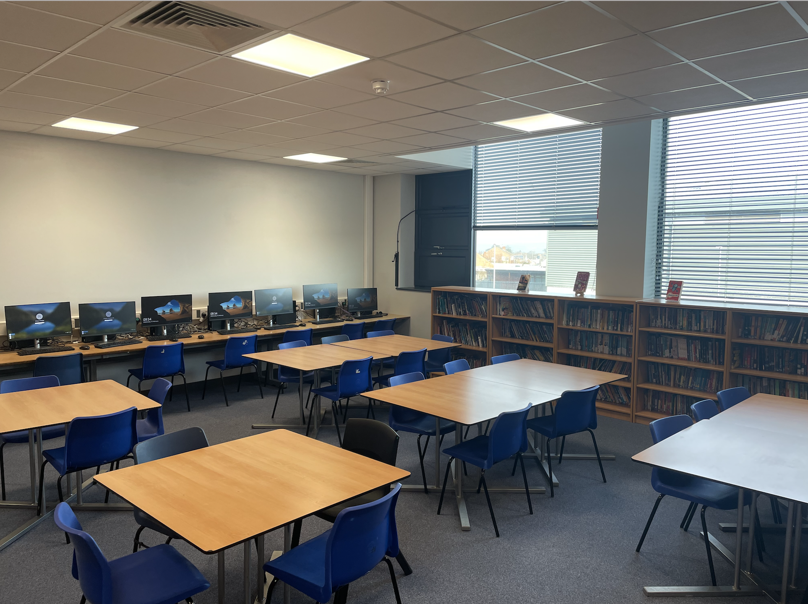
Our New Library
The library is open every day before school from 8am to 8:20am.
The library is open every night after school from 2:30pm till 3:30pm.
Students have the opportunity to become Student Librarians.
The library is located on the English corridor.

