Slide 1
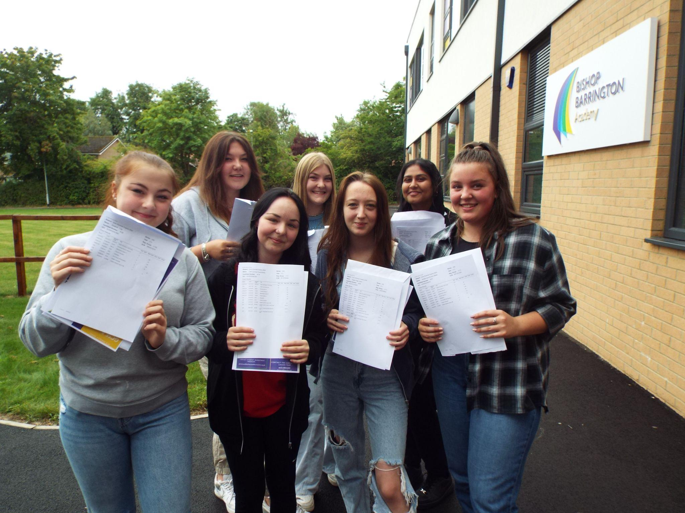
Bishop Barrington Academy
Parental Engage Event
Thursday 22nd September, 5-6.30pm.
“Success at GCSE - information for students and families”

Slide 2

What is Parental Engagement?

Slide 3
English
Mrs Porter - Assistant Headteacher

Slide 4
English Literature - Course Content
AQA Course
Paper 1 - 64 marks 40%
1 hour 45 minutes
Macbeth and A Christmas Carol
Paper 2 - 96 marks 60%
2 hours 15 minutes
An Inspector Calls, Conflict Poetry, Unseen Poetry Question and an Unseen Poetry Comparison Question.
Texts:
Paper 1 - Macbeth and A Christmas Carol
Paper 2 - An Inspector Calls and Power and Conflict Poetry.

Slide 5
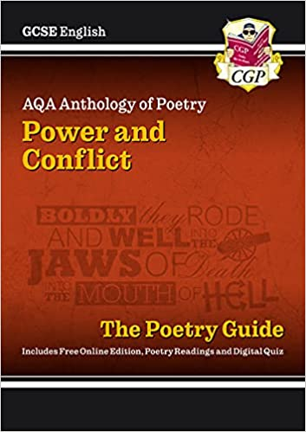
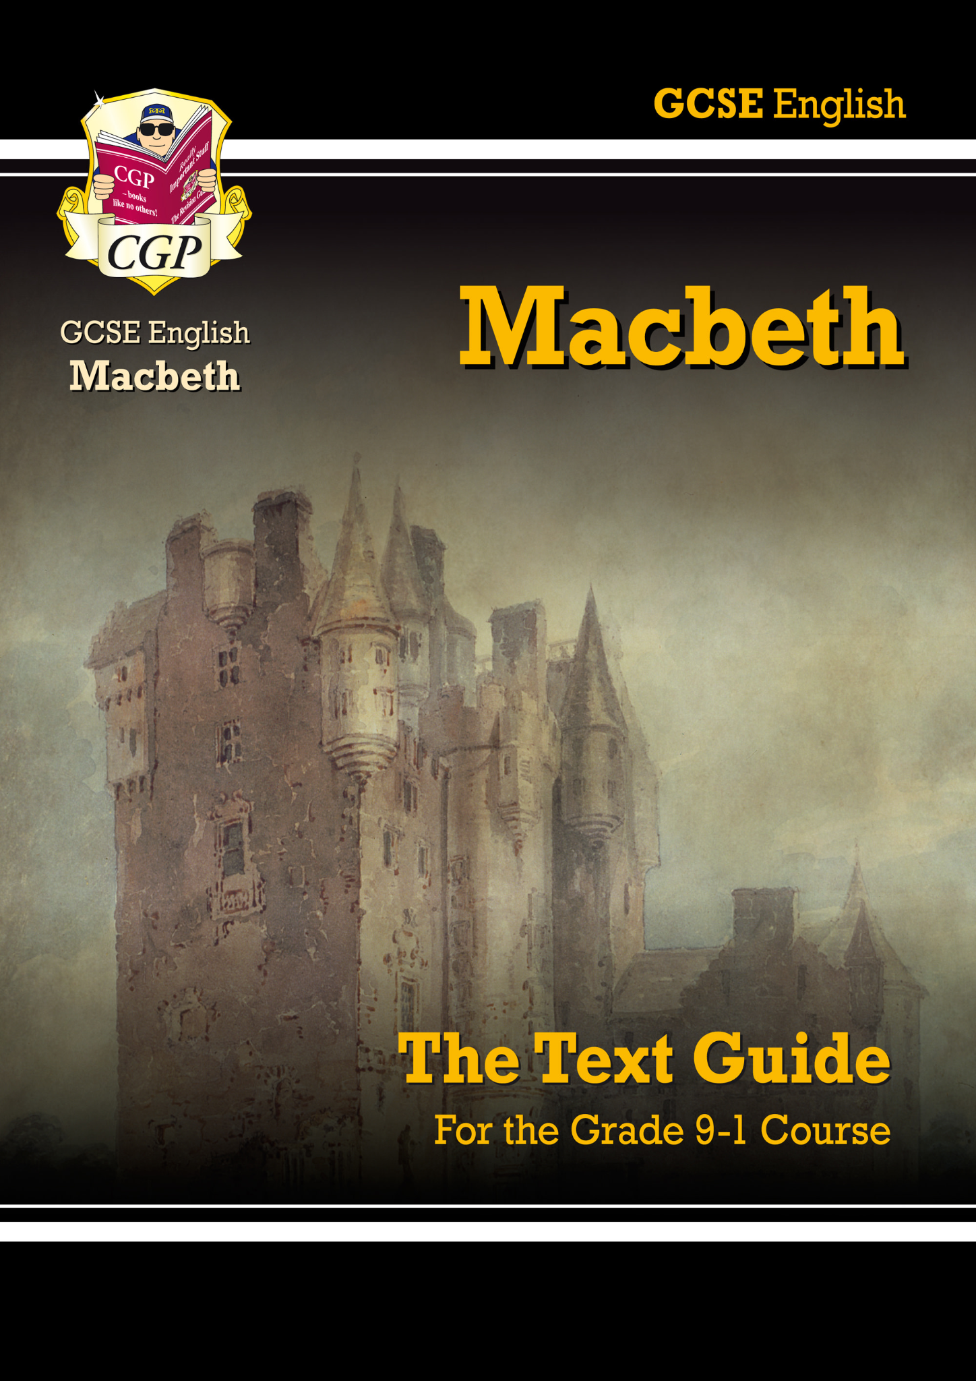
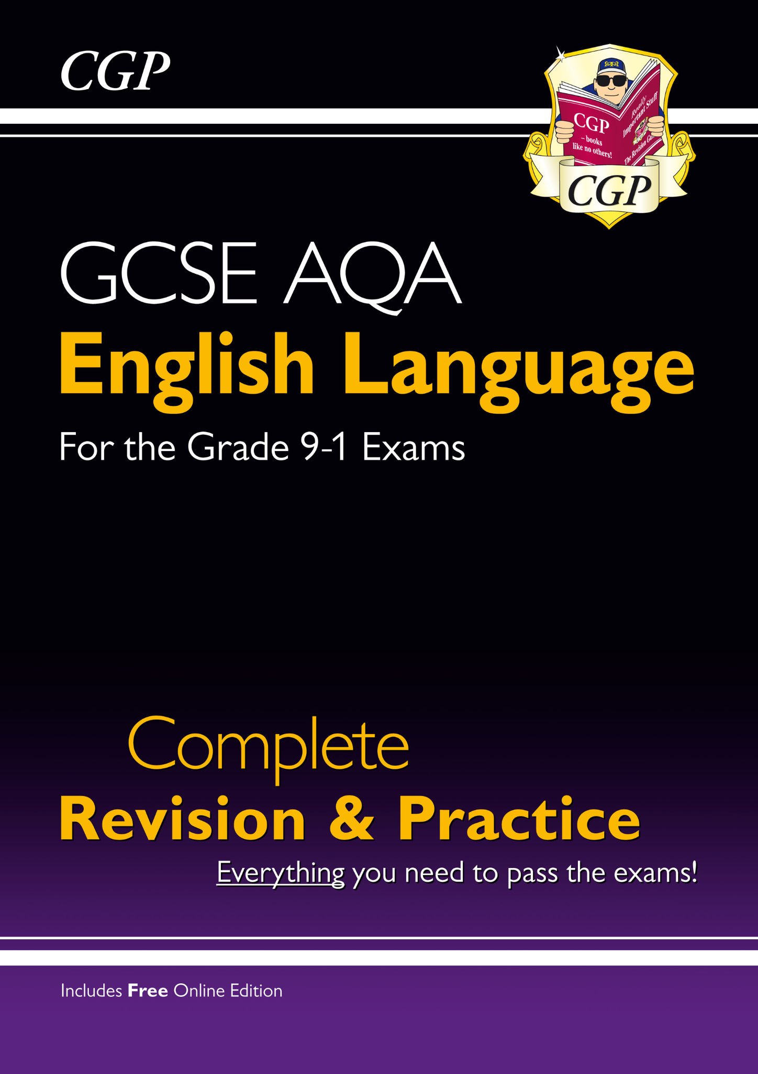
English Literature - Tips to Success
Students will need to revise key quotations for key themes and characters for Macbeth, A Christmas Carol and An Inspector Calls.
Students will be expected to know up to 6 quotations for each theme and character.
For the conflict poetry, students will be expected to remember up to 3 quotations from each poem.

Slide 6
English Literature - Tips to Success
You do not need to buy any revision guides. We will provide students with anything that they need.
Some of the best ways to revise:
Using revision cards.
Revision clocks
Re-reading the texts.
Practicing planning exam questions.

Slide 7
English Language - Course Content
AQA Course
Paper 1 - 80 marks 50%
1 hour 45 minutes
Explorations in creative reading and writing (fiction)
Paper 2 - 80 marks 50%
1 hour 45 minutes
Writers’ viewpoints and perspectives (non-fiction)
Both papers:
Reading Section: 4 questions, 40 marks
Writing Section: 1 question, 40 marks

Slide 8
English Language - Tips to Success
Some of the best ways to revise:
Using revision cards.
Reading a wide range of extracts (fiction and non-fiction).
Practicing planning exam questions – particularly section B on both writing papers.

Slide 9
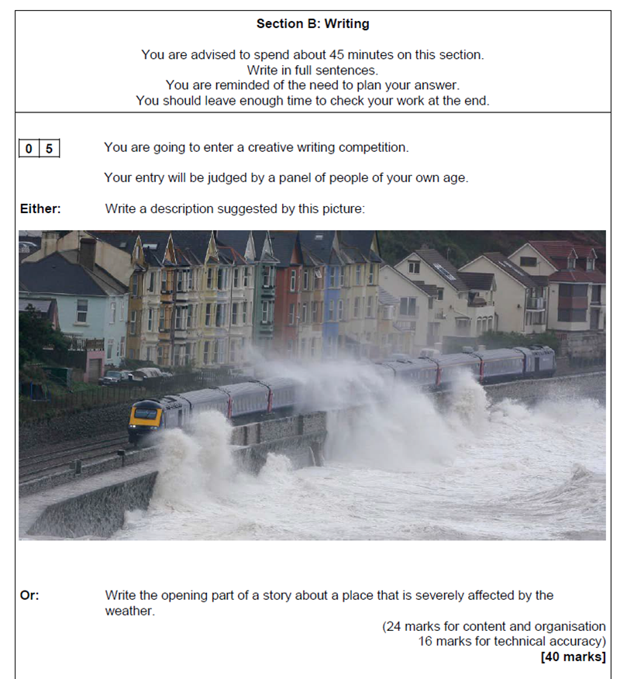
English Language - Exam Question Example
Students need to learn the key skills required for each question.
Students need to know the focus of each of the five language questions (for each paper).

Slide 10
English - Questions & Answers
Is there any coursework?
No. There is no coursework - the grade is based entirely on exams.
Which texts are studied?
Macbeth, A Christmas Carol, An Inspector Calls and Power and Conflict Poetry.
How can my child revise for the English courses?
Practice, practice, practice: skills between the two courses are the same (analysis of language, structure and comparing texts). Reading helps too.
Why is English important?
No matter what your child’s plans are for the future a grade 4 is expected in English for most courses and apprenticeships. They will learn and develop vital skills such as speaking, listening and writing.

Slide 11
Maths
Mr Payne - Head of Maths Department

Slide 12
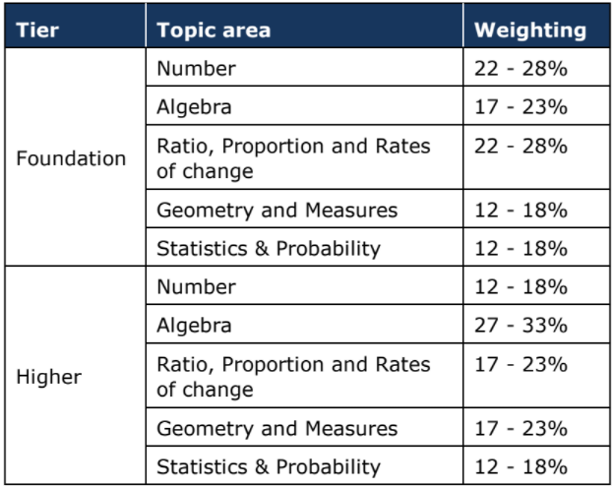
Maths - Course Content
3 exams- 80 marks each; 1 non calculator,
2 calculator;
90 minutes each paper
Content is assessed across all 3 papers- not modular
Choice of tier will be finalised after the mocks in Year 11
Foundation tier: grades 1 to 5
Higher tier: grades 4 to 9
The exam board recommend students on target for grade 4 or 5 enter at foundation tier
Notes:
Previous past paper grade boundaries easily located on mathsbot

Slide 13
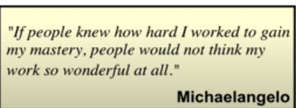
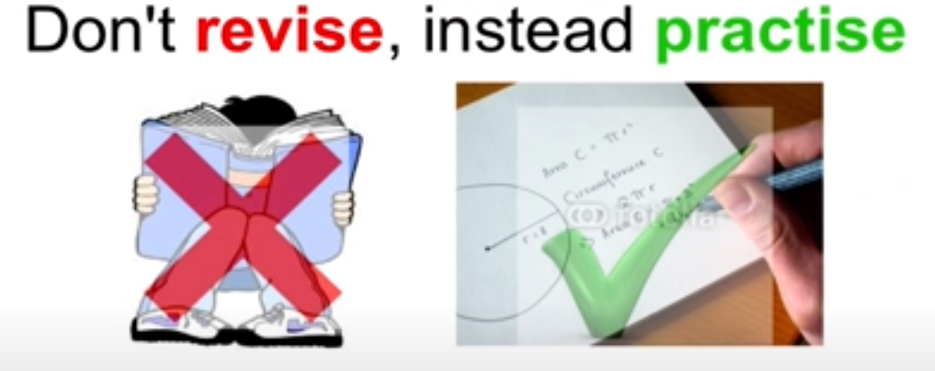
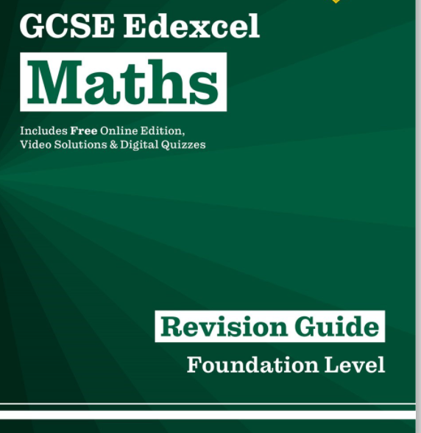
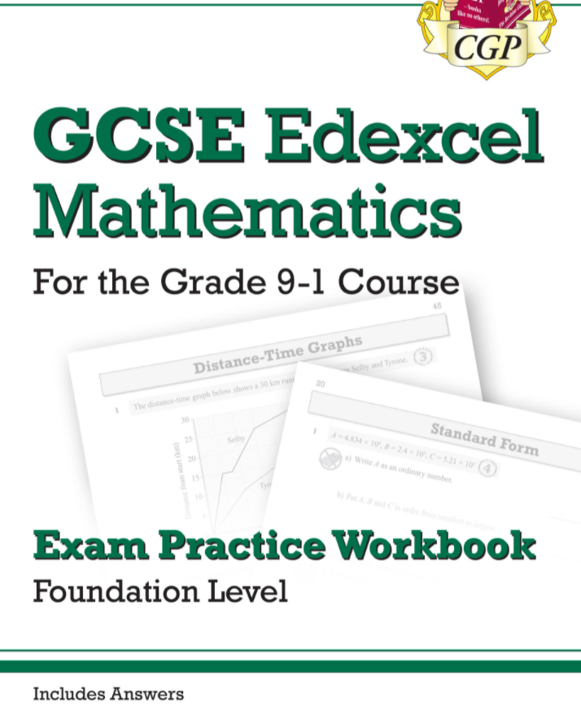
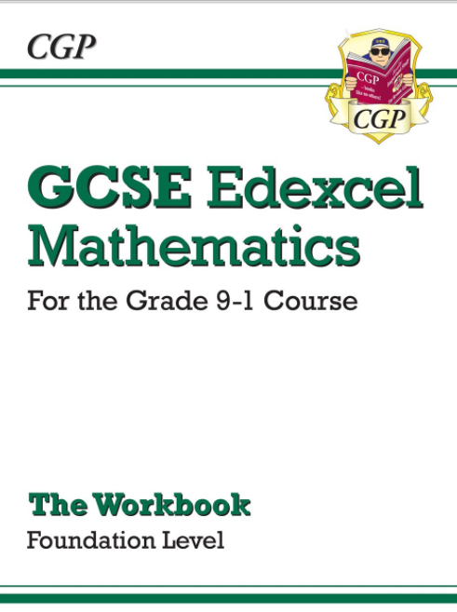
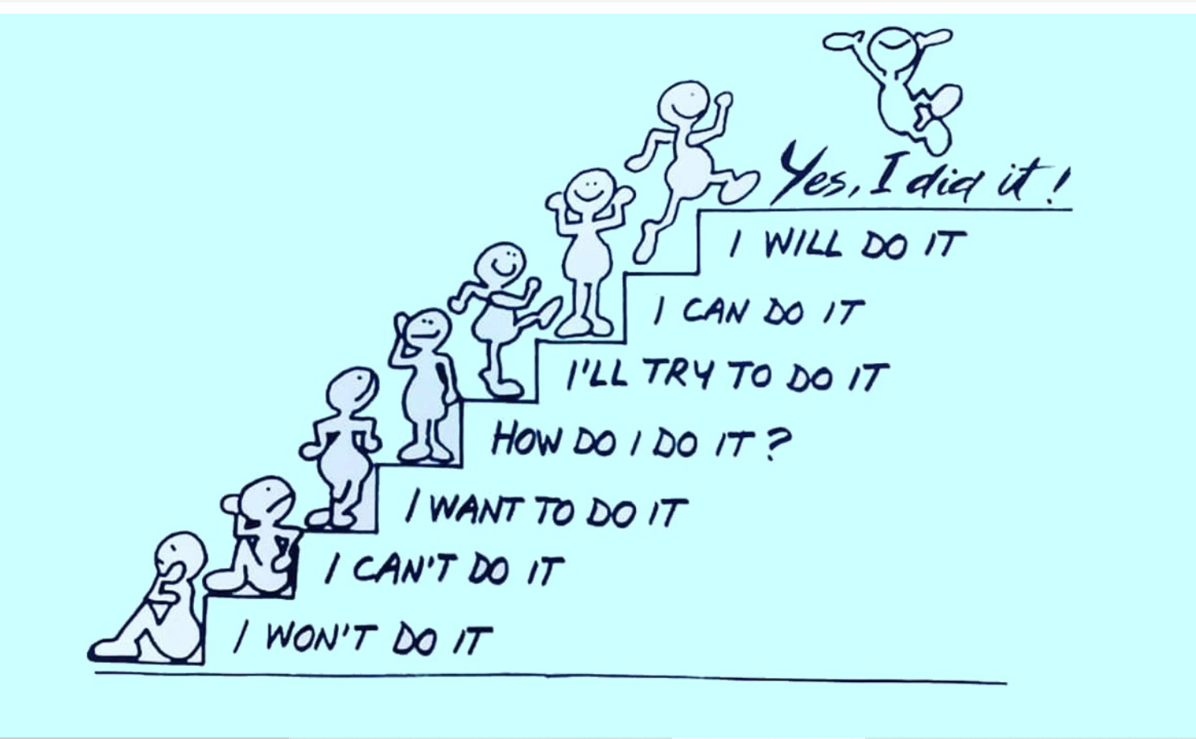
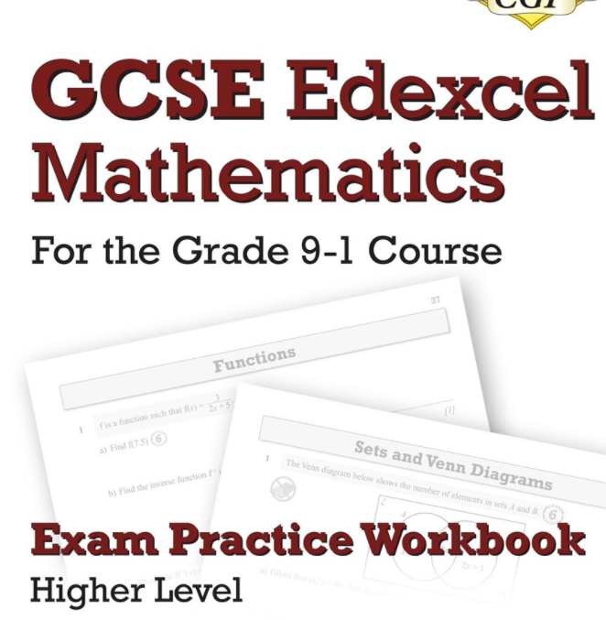
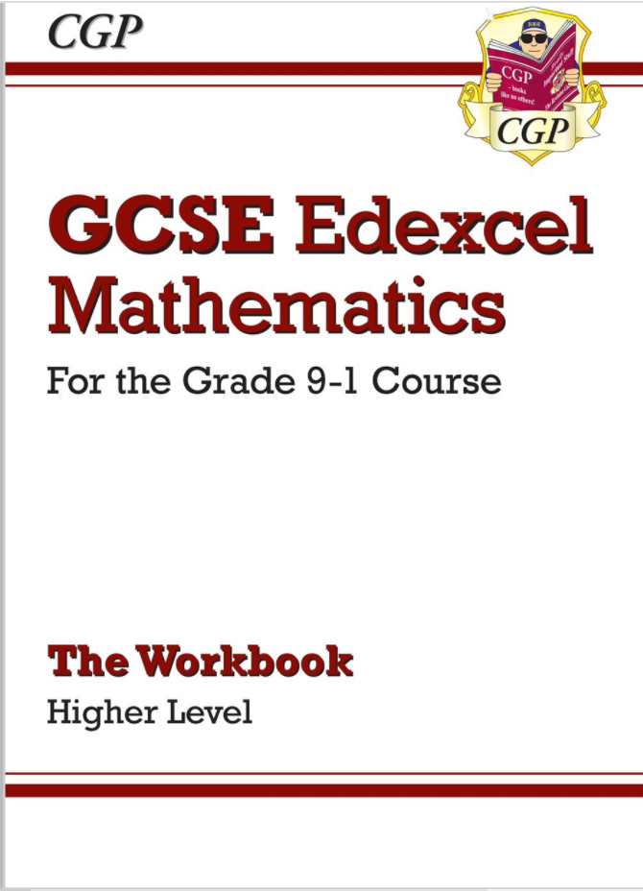
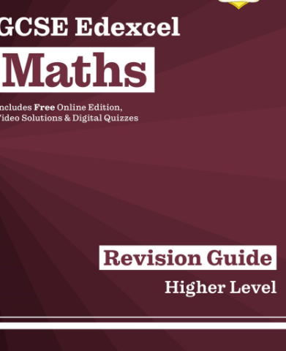
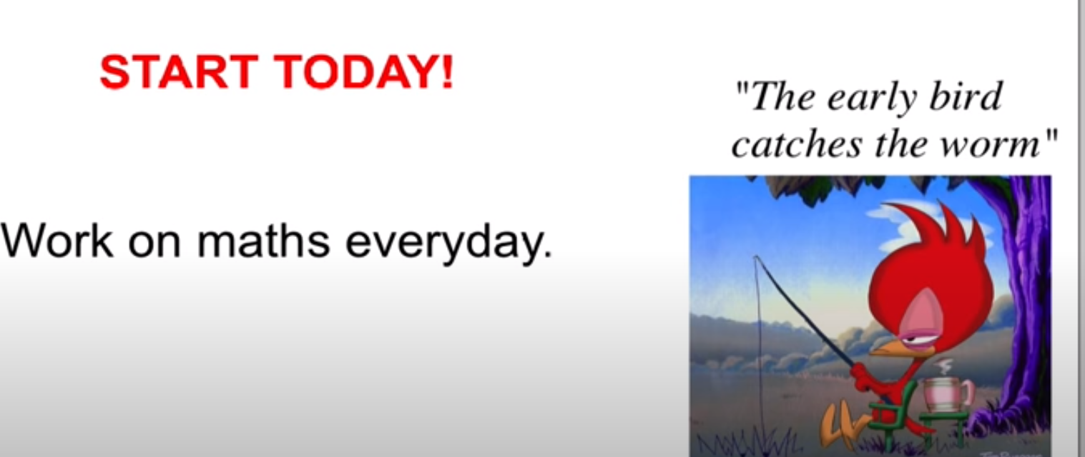
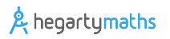
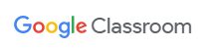
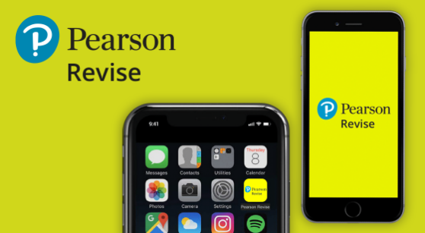
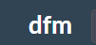
Maths - Tips to Success
How you can help your child with maths
Value maths learning
Encourage them to have a go
Know where they can get support
Ensure homework is done to the best standard
Notes:
Value- don’t say-”It’s ok I couldn’t do maths either/ I’m rubbish at maths” etc- we all want our children to be more successful than we were. Instead say “I found it tricky but with support you can do this”- give parents a narrative
We learn by making mistakes & acting on them
Know

Slide 14
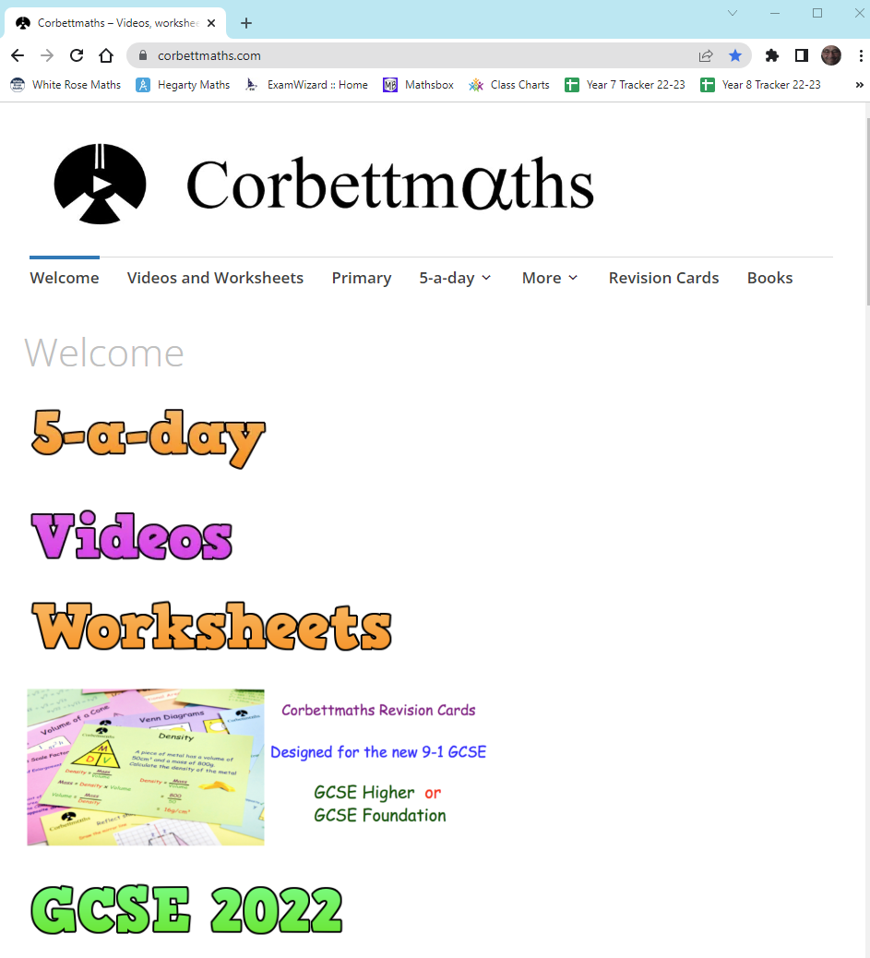
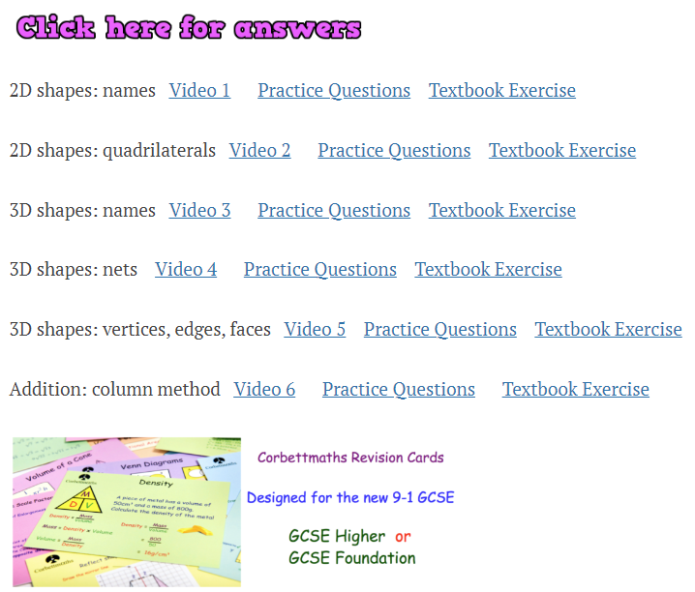
Maths - Resource example - www.corbettmaths.com

Slide 15
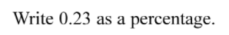
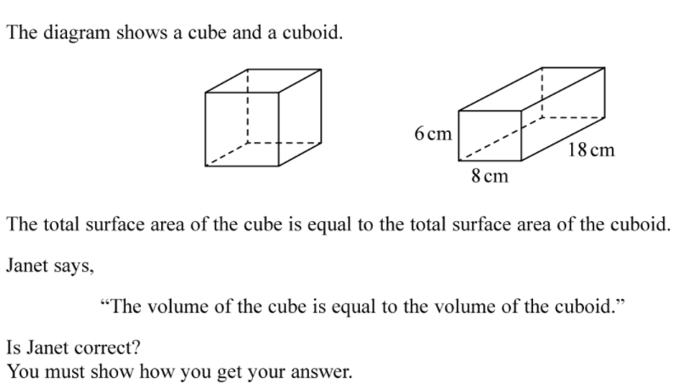
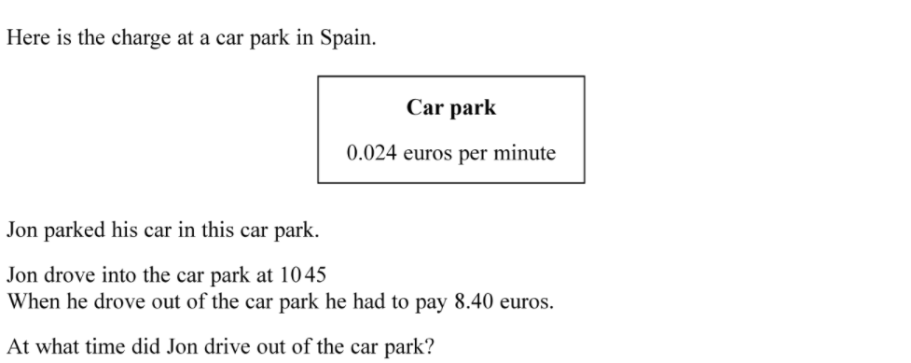
Examples of questions from calculator papers (F/H)
1 mark
Techniques include
Recall
Identifying key terms
Jotting/ sketching to make sense of the problem
5 marks
3 marks
Notes:
Examples of recall, foundation q & overlap q

Slide 16
Maths - Questions & Answers
How much homework should my child be doing in maths?
Homework will be set at least every fortnight and your child should be doing between 40 and 60 minutes
Why does my child need GCSE maths?
Maths underpins so many areas of everyday life as well as supporting learning in other fields.
GCSE maths at grade 4 or above is needed for many post 16 courses and all university courses, and your child will continue to study maths at college if they do not achieve this at the end of year 11
Which exam board do you use?
Edexcel
Notes:
Any questions already sent in?

Slide 17
Science
Mr Galvin - Head of Science Department

Slide 18
Science - Course Content - Edexcel combined science
Each of the three sciences are taught by specialist teachers.
Physics topics include...
Conservation of energy
Radioactivity
Electricity and circuits
Magnetism and the motor effect
2 x GCSE’s awarded
6 exams at the end of year 11
2 x 1hr 10min papers for each of biology, chemistry and physics
Chemistry topics include...
Acids and alkalis
Earth and atmospheric sciences
Rates of reaction
Obtaining and using metals
Foundation and higher tier
Biology topics include...
Natural selection and genetic modification
Health, disease and the development of medicines
Ecosystems and materials sciences

Slide 19
Science - Course Content - Triple science
Each of the three sciences are taught by specialist teachers.
Physics extras...
Astronomy
Static electricity
Nuclear fusion and fission
3 x GCSE’s awarded
6 exams at the end of year 11
2 x 1hr 45min papers for each of biology, chemistry and physics
Students get to show which science they are best at
Chemistry extras...
Quantitative analysis
Qualitative analysis
Hydrocarbons
Polymers
Foundation and higher tier
Biology extras...
Homeostasis
Genetic modification and agriculture

Slide 20
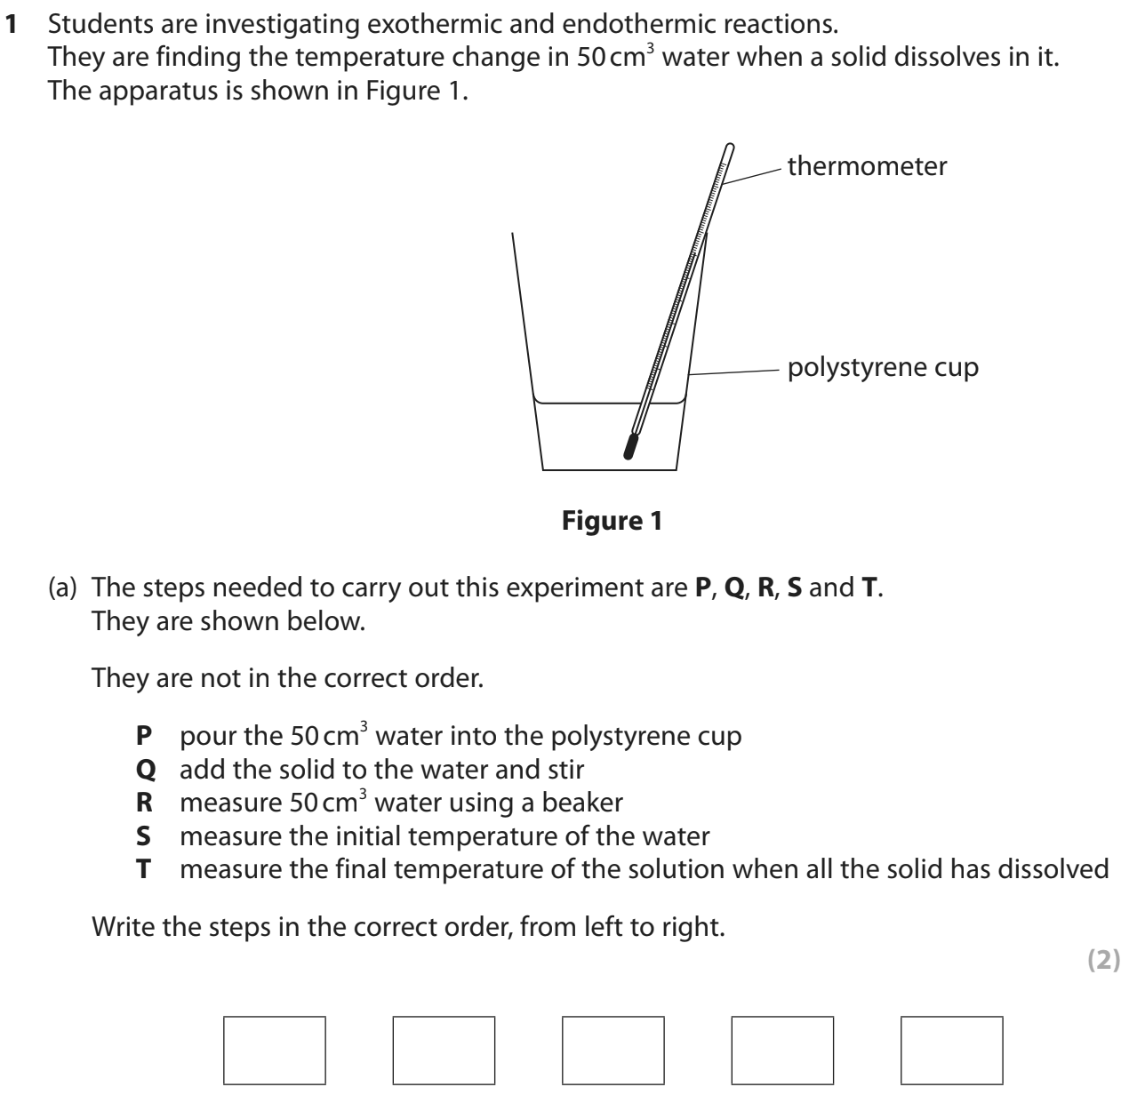
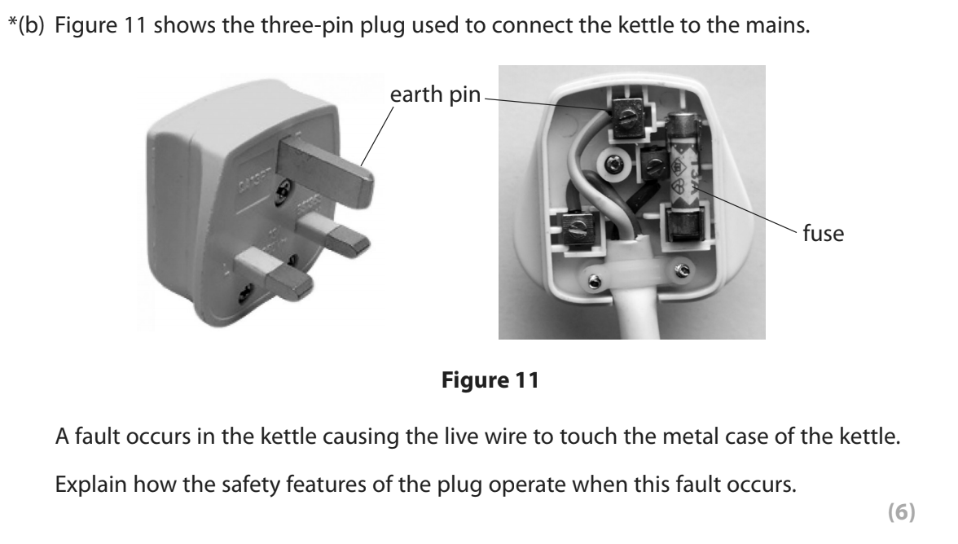
Science- Exam Paper Examples

Slide 21
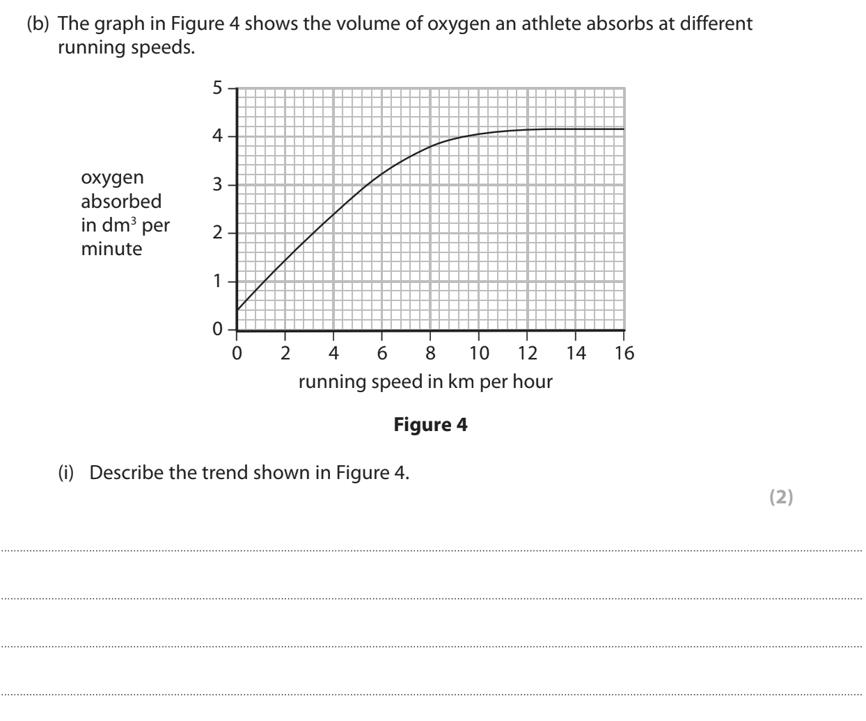
Science- Exam Paper Examples

Slide 22

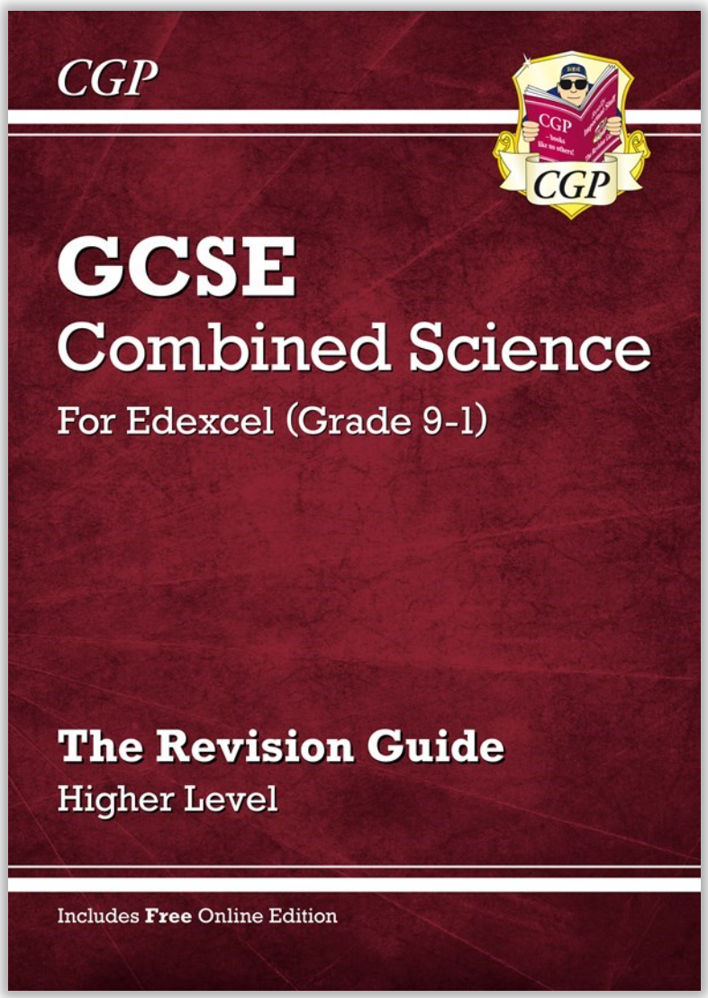


Science- Tips to Success
Work hard
Take an interest in science around you
Practice revising!!!
Reading alone is not revision
Involve others where possible - friends and family can be a great help!!
Free science lessons
Science and maths by primrose kitten
Science with Hazel
Ask your teachers for help!!

Slide 23
Science- Tips to Success
Used spaced retrieval.
Condense learning notes for each topic until you have it down to as few words as possible.
Write questions and answers as you revise.
Test yourself and use past exam questions. They are available for you.
Produce mind maps after revising a topic to help link knowledge.
Free science lessons
Science and maths by primrose kitten
Science with Hazel
Do not struggle on your own. Ask your teachers for help!! In school or on google classroom.

Slide 24
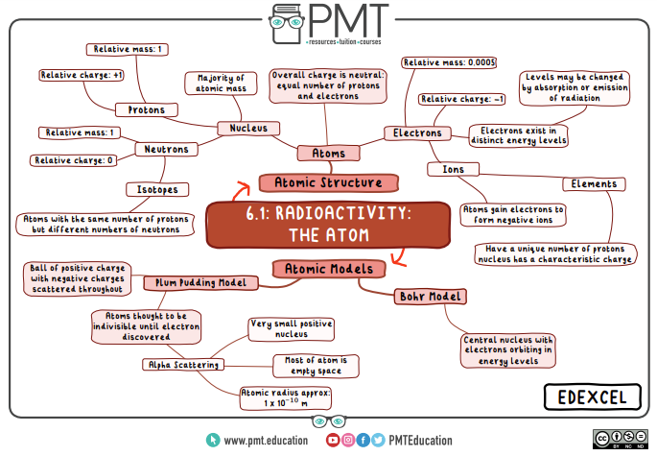
Science- Tips to Success

Slide 25
Science - Questions & Answers
Is there any coursework?
No. There is no coursework - the grade is based entirely on exams.
Do you get a GCSE for each science
For combined science students are awarded 2 GCSE’s based on their performance over the six exams. These are not specific to any of the 3 sciences but include all 3.
For separate sciences yes. Students are awarded 3 GCSE’s, one for each science based on their performance over the 2 exams they sit for that science.
Why do I need to do well in science?
Science will open many doors to colleges, universities or credible alternatives. It will help students develop the skills and knowledge to thrive in top jobs.

